Slide 1
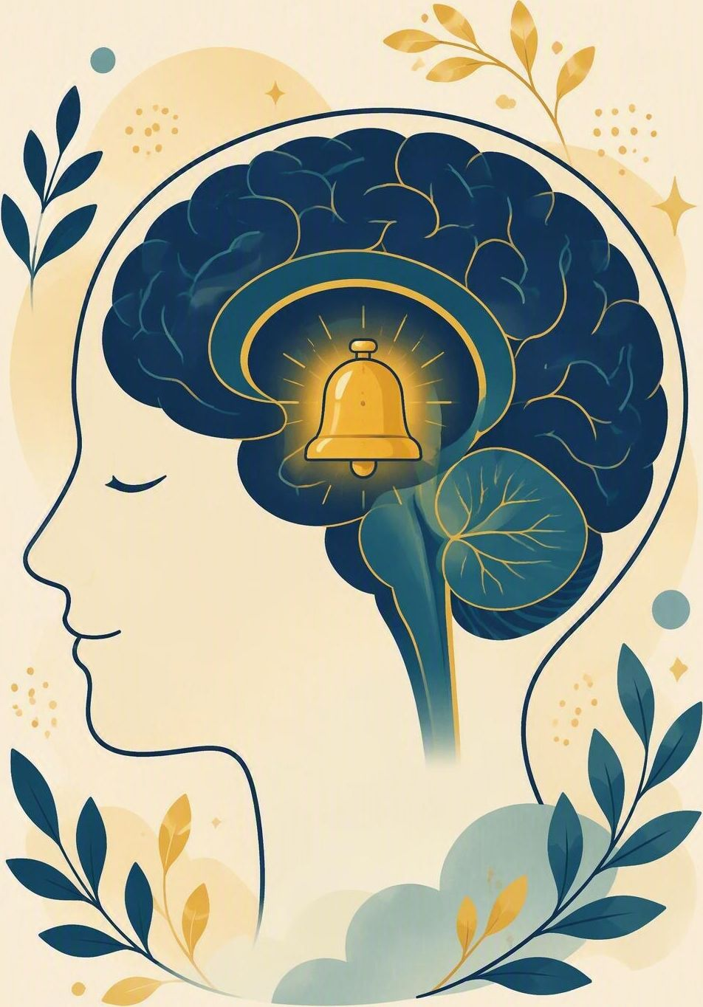
The brain alarm
FLOURISH · CREATION
YEAR 6
T2 · STEADY · REGULATION AND RESILIENCE. Why bodies react first.
#regulation
#resilience
#steady
#calmbody
Notes:
LEARNING INTENTION
• Explain why the body’s alarm reacts first, and name steps that settle it.
KEY QUESTION
• Why does the body sometimes react before the thinking brain catches up?
SAFEGUARDING
• No forced disclosure. Students may pass, write privately or use a fictional example. Follow up any concerns privately using the school support pathway.
ACCESS / LOW-DISCLOSURE
• Read instructions aloud and display them. Allow silent pointing, writing or partner response. Provide extra processing time. Never require eye contact, public role-play, prayer aloud or disclosure of personal distress.
OFFLINE FALLBACK
• Printed brain-alarm diagram plus the six settling-strategy cards.

Slide 2
Why does your body sometimes react before your thinking has caught up?
CONNECT · Hook
T2 · THE BRAIN ALARM · WEEK 1
You can always pass, write your answer privately, or use a made-up example.
CONNECT
EXPLORE
PRACTISE
REFLECT
Notes:
FICTIONAL SCENARIO · JONAH AT THE SWIMMING CARNIVAL
Read this aloud so students respond to the person in the story, not to their own lives. Nobody needs to share anything personal.
Jonah is in Year 6 and his class has a swimming carnival on Friday. When the marshal calls his name for the relay, his heart pounds, his hands go cold and his thinking feels switched off. Nothing dangerous is happening, but his body has reacted as if it is. Afterwards he says he does not know why he froze.
Questions for reflection
• Why did Jonah’s body react before he had time to think it through?
• Which small steps might help Jonah’s alarm settle before his race?
• What could a teammate say that would help him more than telling him to ‘just calm down’?
CONNECT · 1
• Read it aloud: “Why does your body sometimes react before your thinking has caught up?”
• Offer a starter if the room is quiet: think of a moment before a race, a test or a stage - what does a body do in that moment? Take two or three quick responses about bodies, not personal stories.
• Restate the participation options aloud: pass, write privately, or use a fictional example.
CONNECT · TEACHING SCRIPT
• Say: ‘Today we are learning two things: why the brain sets off an alarm before we can think, and which steps help that alarm settle. By the end you will have four steps we can actually use.’
• Read the participation line printed on the slide word for word: 'You can always pass, write your answer privately, or use a made-up example.’
• Ask: ‘Name one thing a body does when the alarm goes off, and one thing that helps it settle.’ Sample answers to fish for: heart races, hands shake, thinking narrows; slow breathing out, naming it, steady feet. Students may think, write privately or pass.
PARTICIPATION
• Students may pass, write privately or use a made-up example. Do not ask for personal disclosure; use the fictional scenario instead.

Slide 3
Psalm 56:3–4
EXPLORE · Christian connection
T2 · THE BRAIN ALARM · WEEK 1
“When I am afraid, I put my trust in you. In God, whose word I praise—in God I trust and am not afraid. What can mere mortals do to me?”
Psalm 56:3–4, New International Version (NIV)
CHRISTIAN CONNECTION
Fear is not a failure; even the psalmist felt it and chose trust. Naming what our body is doing, and who we can trust, helps the alarm settle.
EXPLORE
CONNECT
PRACTISE
REFLECT
Notes:
EXPLORE · 3
• Read Psalm 56:3-4 aloud from the screen, in context.
• Connect the verse to the body’s alarm: the psalmist names fear out loud first, then chooses trust. Naming comes before settling.
TEACHING SCRIPT
• Say: ‘Today’s skill: notice what the body’s alarm does, and use a step that helps it settle.’
• Read the passage in context. It is a psalm written while David was genuinely in danger, not a promise that fear never comes.
• ‘When I am afraid’ means when, not if. The alarm is normal equipment; the choice is what we do next with it.
• Land the connection on the slide: fear is not failure; naming it and trusting God helps the alarm settle.
• Make it concrete for this room: it shows in slow breathing out, naming the feeling, steady feet, and telling a trusted adult.
• Check understanding: ‘If the alarm goes off before thinking does, what is the first step that actually helps?’
• Looking for: slow the breathing out and name the feeling, rather than ordering yourself to stop. Keep answers general - no personal examples needed.
PARTICIPATION
• Students may pass, write privately or use a made-up example.
• Do not ask for personal disclosure; use the fictional scenario instead.

Slide 4
The brain alarm
EXPLORE · Watch together
T2 · THE BRAIN ALARM · WEEK 1
WATCH FOR
The alarm reacts before thinking
Naming a feeling settles it
Psalm 56:3 — “When I am afraid, I trust in you.”
BibleProject · “Shalom / Peace”
bibleproject.com/explore/video/shalom-peace
EXPLORE
CONNECT
PRACTISE
REFLECT

Slide 5
Which norms help us flourish?
PRACTISE · Building our class norms
T1 · FLOURISH BEGINS · WEEK 1
In groups, sort the six cards below: HELPS FLOURISH or NEEDS EDITING.
Then agree on the four norms this class will actually keep.
1
Whatever is said here stays here, always
2
Concerns go to a trusted adult
3
Privacy is respected
4
Everyone must share something
5
Pass is allowed
6
Fictional examples are okay
Cards 5 and 6 are the drafts that need editing — rewrite them together, then keep your final four.
PRACTISE
CONNECT
EXPLORE
REFLECT
Notes:
PRACTISE - 4 - RUN SHEET
• SET UP (30 sec)
• Groups of 3-4. Each group gets the six cards (printed, or read from the screen). Say: "Four of these are ready to use. Two of them have a problem. Your job is to work out which two."
• SORT (2 min)
• Groups sort all six into HELPS FLOURISH / NEEDS EDITING. Circulate and listen; do not correct yet.
THE FOUR THAT WORK
• 2. Concerns go to a trusted adult - if something worries us, we tell an adult who can help.
• 3. Privacy is respected - we do not repeat someone's story outside this room.
• 5. Pass is allowed - you can always opt out of answering.
• 6. Fictional examples are okay - you can use a made-up example instead of your own.
THE TWO THAT NEED EDITING - and why
• 1. "Whatever is said here stays here, always." Problem: it sounds caring, but it promises secrecy that cannot be kept - safety concerns must be passed on. Class rewrite might be: "What is said here stays here, unless someone is unsafe - then it goes to a trusted adult."
• 4. "Everyone must share something." Problem: it removes the right to pass and pressures disclosure. Class rewrite might be: "Everyone gets a turn, and passing counts as a turn."
• If a group defends card 1 or 4, ask: "What would that rule feel like for someone having a hard week?" and "Is that a promise a teacher could actually keep?"
• AGREE (2 min)
• Bring the class back. Land the four norms above as the class agreement. Display or write them up and keep them visible for the rest of the term - refer back to them in Weeks 2-8.
ACCESS
• Read the cards aloud as well as displaying them. Allow silent pointing, writing, or a partner answering on a student's behalf. Give extra processing time. No public role-play, no forced disclosure.
OFFLINE FALLBACK
• Six printed norm cards (wording above), one set per group.

Slide 6
“One action I can take to make this group safer for learning is …”
REFLECT · Reflection and action
T1 · FLOURISH BEGINS · WEEK 1
Write this one privately — you don't have to share it.
TAKEAWAY
Dignity is received, and safe participation is something we build together.
REFLECT
CONNECT
EXPLORE
PRACTISE
Notes:
REFLECT · 2
• Give students the private stem: "One action I can take to make this group safer for learning is ..." Keep it silent and private - no sharing required.
• Close with a short prayer, blessing or silent reflection appropriate to the class. Never require prayer aloud.
• Follow up any concerns privately using the school support pathway.
REFLECT · TEACHING SCRIPT (last 2-3 minutes)
• Read the stem printed on the slide: 'One action I can take to make this group safer for learning is ...' Students write it privately.
• Model the size of answer you want: 'I could let someone finish before I jump in', or 'I could sit with whoever is on their own'. Small and doable beats impressive. Sharing is optional; students may say 'pass'.
• Close with the takeaway on the slide: 'Dignity is received, and safe participation is something we build together. The four norms we agreed today are ours for the whole term.' Offer a brief prayer, blessing or quiet pause according to school practice.
PARTICIPATION
• Students may pass, write privately or use a made-up example. Do not ask for personal disclosure; use the fictional scenario instead.

