Slide 1
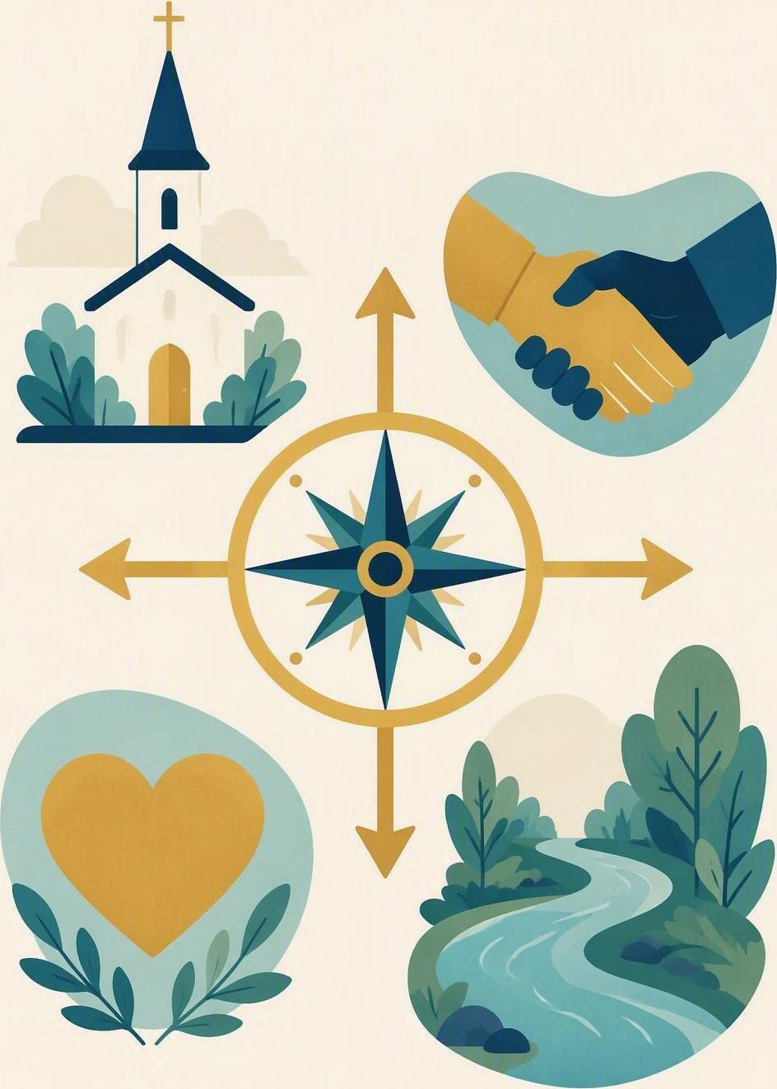
The Shalom compass
FLOURISH · RESTORATION
YEAR 6
Four relationship directions that describe what helps people and places thrive.
#helpseeking
#respectfulrelationships
#creationcare
#service
Notes:
LEARNING INTENTION
• We are learning to use four relationship directions – God, others, self and creation – to describe what helps people and communities thrive.
SUCCESS CHECK
• I can use the four directions to describe what helps people and communities thrive in the fictional case, and explain my choice.
KEY QUESTION
• Which relationships are affected when a group excludes someone and wastes materials?
NIV CONNECTION
• Mark 12:30–31; Genesis 2 – love God and neighbour; cultivate and care for creation.
CHRISTIAN FORMATION
• Shalom is more than a calm feeling. It describes right, truthful and life-giving relationship with God, other people, oneself as God’s creature, and the created world. Because the directions are connected, one restoring action can strengthen several at once.
• CSA alignment: Relationships / Belonging; Serving / Embodying; Spirituality / Expressing. Character focus: service and stewardship.
RETRIEVAL BRIDGE
• Retrieve one body clue and one precise feeling word that could help someone notice a break in shalom.
PREPARE IN UNDER 5 MINUTES
• Draw a compass with four labelled arrows: GOD / OTHERS / SELF / CREATION. Leave room beside each arrow for evidence.
SAFEGUARDING
• No forced disclosure. Students may pass, write privately or use a fictional example. Follow up any concerns privately using the school support pathway.
ACCESS / LOW-DISCLOSURE
• Read instructions aloud and display them. Allow silent pointing, writing or partner response. Provide extra processing time. Never require eye contact, public role-play, prayer aloud or disclosure of personal distress.
OFFLINE FALLBACK
• Hand-drawn four-arrow compass on the board plus six printed action cards.

Slide 2
A group leaves one member out and wastes the materials. Which relationships does that damage?
CONNECT · Four arrows
T1 · THE SHALOM COMPASS · WEEK 5
You can always pass, write your answer privately, or use a made-up example.
CONNECT
EXPLORE
PRACTISE
REFLECT
Notes:
FICTIONAL SCENARIO · THE WATERWAY POSTER
Read this aloud so students respond to the people in the story, not to their own lives. Nobody needs to share anything personal.
A science group is making a poster about a local waterway. Lee’s idea about native plants is ignored and Lee is left without a role. Two students take over the page, paper scraps fall to the floor and glue lids are left open. At presentation time the group says, “We all contributed.”
Questions for reflection
• Which of the four directions – God, others, self, creation – are broken here?
• Which break is the most immediate, and what second direction is linked to it?
• What restoring action would touch at least two directions, and who does what next?
CONNECT
• Read it aloud: “A group leaves one member out and wastes the materials. Which relationships does that damage?”
• Restate the participation options aloud: pass, write privately, or use a fictional example.
TEACHING SCRIPT
• Point to the four compass arrows – GOD, OTHERS, SELF, CREATION.
• Ask students to predict which direction is affected when a group excludes a member and wastes materials. Thinking time first; no hands-up pressure.
TEACHING SCRIPT
• Take four rapid answers – ideally one per direction.
• Say: “The compass does not tell us that every problem feels peaceful; it helps us see relationships that need faithful care.”
ANSWERS TO FISH FOR
• OTHERS – someone is shut out of the work. SELF – the excluded person’s dignity and the takers’ self-control. CREATION – wasted paper and dried-out glue. GOD – the whole pattern of loving neighbour and caring for what we are given.
• If students name only one direction, ask: “What else got damaged that nobody is talking about?”
RETRIEVAL BRIDGE
• Retrieve one body clue and one precise feeling word that could help someone notice a break in shalom.
PARTICIPATION
• Students may pass, write privately or use a fictional example. Do not ask for personal disclosure; use the fictional scenario instead.

Slide 3
Mark 12:30–31
EXPLORE · Christian connection
T1 · THE SHALOM COMPASS · WEEK 5
“Love the Lord your God with all your heart and with all your soul and with all your mind and with all your strength.’ The second is this: ‘Love your neighbour as yourself.’ There is no commandment greater than these.”
Mark 12:30–31, New International Version (NIV)
CHRISTIAN CONNECTION
Shalom is more than a calm feeling — it is right, truthful and life-giving relationship with God, others, ourselves and creation. Because these directions are connected, one restoring action can strengthen several at once.
EXPLORE
CONNECT
PRACTISE
REFLECT
Notes:
EXPLORE
• Read Mark 12:30–31 and Genesis 2:15 aloud from the screen, in context.
TEACHING SCRIPT
• Define flourishing: growing towards God’s good purposes – not winning every contest or avoiding every difficulty.
• Say: “Shalom is more than a calm feeling. It is right, truthful, life-giving relationship – with God, with others, with yourself, and with the created world.”
TEACHING SCRIPT
• Give one worked example: cleaning a shared table can care for creation, respect others, practise self-control and honour God – one action, four directions.
• Land the big idea: because the directions are connected, one restoring action can strengthen several at once.
TEACHING SCRIPT
• Read Mark 12:30–31 and Genesis 2:15 from the NIV. Connect worship, neighbour-love and stewardship – without collapsing them into the same relationship.
• Genesis 2:15 – humans are placed in the garden to work it and take care of it. Care for creation is a given task, not an optional extra.
• Loving God is not the same as being nice to people, and caring for a river is not the same as loving a neighbour – but all three belong together.
CHECK UNDERSTANDING
• Ask: “Name one everyday action that serves more than one direction at once.”
• Looking for: a concrete action plus at least two named directions – for example, sharing tools fairly serves others and creation. Keep answers general; no personal examples needed.
PARTICIPATION
• Students may pass, write privately or use a fictional example. Do not ask for personal disclosure; use the fictional scenario instead.

Slide 4
Which actions would truly restore shalom in this group?
PRACTISE · Four-direction case map
T1 · THE SHALOM COMPASS · WEEK 5
Map one fact from the case beside each compass direction.
Sort the six cards, then design one restoring action that names who does what next.
1
Give Lee the tidying-up job while the others finish
2
Pause the poster and ask Lee which role Lee would like
3
Move on quickly and hope Lee forgets about it
4
Tidy the scraps and close the glue lids together
5
Add the native-plant idea and name whose idea it was
6
Say “We all contributed” so the group looks good
Test each card: does it tell the truth? Restore participation? Care for materials?
PRACTISE
CONNECT
EXPLORE
REFLECT
Notes:
PRACTISE · RUN SHEET
• MAP THE CASE
• Students copy the compass and place one fact from the case beside each relevant direction. Some facts may belong in more than one place.
• FIND THE BREAK
• Circle the most immediate break in relationship and underline a second direction linked to it.
• DESIGN THE ACTION
• Design one restoring action that touches at least two directions. It must name who does what next.
• PARTNER TEST
• Partners test the action: Does it tell the truth? Restore participation? Care for materials? Avoid pretending the harm did not happen?
SORTING THE SIX CARDS
• Three cards restore shalom; three only look like repair. Do not tell students which is which. Circulate and listen; do not correct yet.
THE THREE THAT RESTORE
• Pause the poster and ask Lee which role Lee would like – restores participation (OTHERS, SELF) and tells the truth about what happened.
• Add the native-plant idea and name whose idea it was – restores credit and honesty (OTHERS, SELF) and serves the waterway (CREATION).
• Tidy the scraps and close the glue lids together – shared stewardship (CREATION, OTHERS), not a punishment for one person.
THE THREE THAT NEED EDITING – and why
• “We all contributed” so the group looks good. Problem: it is not true, and it hides the harm rather than repairing it (breaks truth with GOD, OTHERS and SELF).
• Give Lee the tidying-up job while the others finish. Problem: it looks helpful but keeps Lee out of the real work – exclusion with a chore attached.
• Move on quickly and hope Lee forgets. Problem: avoidance is not restoration; nothing is named, nothing is repaired, the mess stays.
• If a group defends a weak card, ask: “Does that tell the truth?” and “How would that feel if you were Lee on Monday?”
MODEL RESPONSE
• “Pause the group, acknowledge that Lee’s idea and role were missed, give Lee the recording role if Lee agrees, add the native-plant idea, and tidy the materials together.” This serves others and creation while forming humility and integrity.
FORMATIVE LOOK-FOR
• Students use all four directions accurately and propose a concrete restoring action that names who does what next.
ACCESS
• Read the case and the cards aloud as well as displaying them. Allow silent pointing, writing, or a partner answering on a student’s behalf. Give extra processing time. No public role-play, no forced disclosure.
OFFLINE FALLBACK
• Board compass plus six printed action cards (wording above), one set per group.
PARTICIPATION
• Students may pass, write privately or use a fictional example. Do not ask for personal disclosure; use the fictional scenario instead.

Slide 5
“Shalom is strengthened when … because it repairs the relationship with …”
REFLECT · Reflection and action
T1 · THE SHALOM COMPASS · WEEK 5
Write this one privately — you don't have to share it.
TAKEAWAY
One honest restoring action can strengthen several relationships at once.
REFLECT
CONNECT
EXPLORE
PRACTISE
Notes:
REFLECT
• Give students the private stem: “Shalom is strengthened when … because it repairs the relationship with …” Keep it silent and private – no sharing required.
• Follow up any concerns privately using the school support pathway.
TEACHING SCRIPT
• Students finish the stem in writing. Model the size of answer you want: “Shalom is strengthened when we ask Lee what role Lee wants, because it repairs the relationship with the person we left out.” Small and doable beats impressive.
TEACHING SCRIPT
• Students draw a small star on the compass direction that today’s action most clearly served. Some will star two – that is the point.
TEACHING SCRIPT
• Optional class prayer: “Lord Jesus, teach us to love God, neighbour and creation with honest, practical care. Amen.” Never require prayer aloud; offer a blessing or quiet pause instead if that suits the class.
• Close with the takeaway on the slide: one honest restoring action can strengthen several relationships at once.
FORMATIVE LOOK-FOR
• Students use all four directions accurately and propose a concrete restoring action. Watch for stems that name a direction but no action, or an action with no relationship named.
PARTICIPATION
• Students may pass, write privately or use a fictional example. Do not ask for personal disclosure; use the fictional scenario instead.

