Slide 1
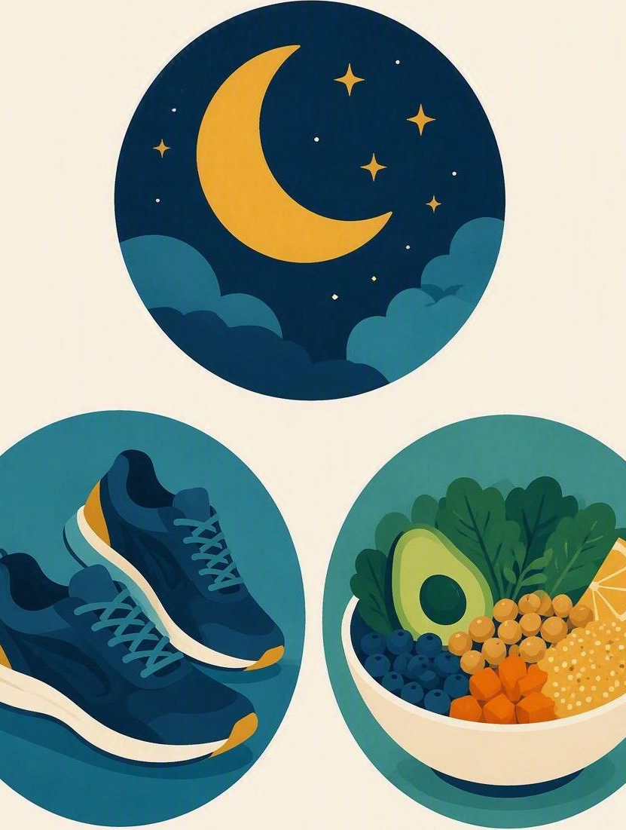
Sleep, move, fuel
FLOURISH · FALL
YEAR 6
Habits that support learning and mood.
#sleep
#movement
#fuel
#habits
Notes:
LEARNING INTENTION
• We are learning how sleep, movement and food affect learning and mood, and how to choose one habit to change.
SUCCESS CHECK
• I can explain how one habit affects learning or mood in the fictional case, and name one small change with a reason.
KEY QUESTION
• Which habit change would make the biggest difference to a school day?
NIV CONNECTION
• 1 Corinthians 6:19–20 – the body held in trust and honoured through ordinary care. Year 6, Term 4; READY – independence and transition.
CHRISTIAN FORMATION
• Scripture treats the body as a gift held in trust rather than a machine to push to the limit. Sleeping, moving and eating well are ordinary ways of honouring God, and part of growing into responsible independence.
RETRIEVAL BRIDGE
• Retrieve one independence habit from Week 2 and explain how sleep, movement or fuel would help that habit hold up next year.
PREPARE IN UNDER 5 MINUTES
• Write SLEEP · MOVE · FUEL on the board with an arrow to LEARNING and MOOD. Read the four clue strips and six sorting cards in the practise section.
SAFEGUARDING
• No forced disclosure. Sleep, food and bodies can touch on home circumstances, hunger, body image or health conditions. Students may pass, write privately or answer as Maya. Never comment on any student’s body, weight or diet. Follow up any concerns privately using the school support pathway.
ACCESS / LOW-DISCLOSURE
• Read every prompt aloud and display it. Offer a habit-word bank on the board – sleep, move, fuel. Allow silent pointing, writing or partner response, and give extra processing time. Never require eye contact, public role-play, prayer aloud or disclosure of personal routines, meals or sleep.
OFFLINE FALLBACK
• Printed sleep / move / fuel chart, the four clue strips and the six sorting cards, one set per group.

Slide 2
Sleep, movement, food: which one changes your school day the most?
CONNECT · Three habits
T4 · SLEEP, MOVE, FUEL · WEEK 3
You can always pass, write your answer privately, or use a made-up example.
CONNECT
EXPLORE
PRACTISE
REFLECT
Notes:
FICTIONAL SCENARIO · MAYA AND THE 6:40 ALARM
Read this aloud so students respond to the person in the story, not to their own lives. Nobody needs to share anything personal.
Maya is in her last term of Year 6 and wants to be ready for high school. Lately she watches videos on her tablet until nearly midnight, sleeps about six hours, skips breakfast to catch the earlier bus, and has stopped kicking a ball around at weekends. By Wednesday she is rereading the same page, feels shaky before lunch, and snaps at her friends.
Questions for reflection
• Which habit changed first for Maya, and what did that change set off?
• Which clues in the story point to sleep, which to movement, and which to fuel?
• If Maya changed one small habit tonight, what might she notice tomorrow?
CONNECT
• Read it aloud: “Sleep, movement, food: which one changes your school day the most?”
• Restate the participation options aloud: pass, write privately, or use a fictional example.
TEACHING SCRIPT
• Ask students to picture the same Tuesday twice: once after six hours of sleep and no breakfast, once after nine hours and something to eat before the bus.
• Then ask: “Sleep, movement, food: which one changes your school day the most?” Take two or three quick responses – no hands-up pressure.
• Looking for: students link a habit to a concrete effect on concentration, patience or energy, rather than saying it is just healthy.
TEACHING SCRIPT
• Students pick one of the three habits and silently write one sentence: “When I change ____, I notice ____.” Answering as Maya is fine.
• Keep it silent and private. This is a warm-up, not a share-round. Collect nothing; one or two volunteers may read a sentence if they want to.
MODEL RESPONSE
• Habit: sleep. Effect: after a late night I reread the same page three times and lose patience over small things.
FORMATIVE LOOK-FOR
• Students connect a specific habit to a specific effect on learning or mood, without being handed the link.
PARTICIPATION
• Students may pass, write privately or use a fictional example. Do not ask for personal disclosure; answering as Maya is always acceptable.

Slide 3
1 Corinthians 6:19–20
EXPLORE · Christian connection
T4 · SLEEP, MOVE, FUEL · WEEK 3
“Do you not know that your bodies are temples of the Holy Spirit, who is in you, whom you have received from God? You are not your own; you were bought at a price. Therefore honor God with your bodies.”
1 Corinthians 6:19–20, New International Version (NIV)
CHRISTIAN CONNECTION
Paul treats the body as something entrusted to us, not something to run into the ground. Rest, movement and food are part of honouring God.
EXPLORE
CONNECT
PRACTISE
REFLECT
Notes:
EXPLORE
• Read 1 Corinthians 6:19–20 aloud from the screen, in context.
• Land the connection: caring for the body is ordinary faithfulness, not vanity and not self-indulgence.
TEACHING SCRIPT
• Teach the why: sleep consolidates what was learned that day; movement lifts attention and mood; food steadies energy and concentration. A tired brain holds less and snaps sooner.
• Check understanding: “If someone cannot concentrate straight after lunch, which of the three habits would you ask about first, and why?”
TEACHING SCRIPT
• Separate the habit from the verdict. “I was tired today” names something changeable. “I will never be a morning person” turns one hard week into a fixed identity.
• Looking for: students can tell a changeable habit apart from a fixed claim about themselves.
TEACHING SCRIPT
• Read 1 Corinthians 6:19–20 from the NIV. Paul is writing that the body itself belongs to God and is worth treating with care.
• Say: Looking after sleep, movement and food is not vanity. It is one ordinary way of honouring God with the body you have been given.
• Keep answers general – no personal examples about meals, sleep or bodies are needed here.
FORMATIVE LOOK-FOR
• Students explain a habit’s effect with a reason, and avoid turning a hard week into a fixed statement about themselves.
PARTICIPATION
• Students may pass, write privately or use a fictional example. Do not ask for personal disclosure; answering as Maya is always acceptable.

Slide 4
Which sentences give a useful clue about what would actually help?
PRACTISE · Habit sort
T4 · SLEEP, MOVE, FUEL · WEEK 3
In groups, read all six cards and sort them.
For each card you set aside, write a more useful version.
1
I will never be a morning person.
2
I charge my tablet outside my room, so I fall asleep sooner.
3
I ate breakfast, so I was not starving by second lesson.
4
I was just tired.
5
I slept eight hours and found the reading easier this morning.
6
I walked for fifteen minutes at lunch and felt calmer after.
Several habits can help – aim for one small change you could actually keep.
PRACTISE
CONNECT
EXPLORE
REFLECT
Notes:
PRACTISE · RUN SHEET
• SET UP
• Groups of 3–4. Draw three columns headed SLEEP, MOVE and FUEL, with a row for LEARNING and a row for MOOD. Read the Maya scenario aloud before they start.
• MATCH THE CLUES
• Read the four clues: “rereads the same page”; “snaps at friends by Wednesday”; “shaky and unfocused before lunch”; “stiff and restless all afternoon”. Students match each clue to sleep, movement or fuel. Circulate and listen; do not correct yet.
• Likely matches: rereads the same page → sleep; snaps at friends → sleep and movement; shaky before lunch → fuel; stiff and restless → movement.
• CHOOSE AND EXPLAIN
• Choose two small changes Maya could make. For each, complete: “If Maya changes ____, tomorrow she might notice ____.”
• SHARE AND LAND
• Take two answers. Emphasise that the three habits overlap; the goal is one small, keepable change with a reason. Do not award a single “right” habit.
SORTING CARDS · ANSWERS (teacher only)
• Useful and usable: cards 2, 3, 5 and 6 – each names a specific habit and ties it to an effect you could actually notice.
• Card 1, “I will never be a morning person.” Problem: it turns one hard week into a fixed fact about yourself. Rewrite: “Mornings are hard at the moment because I go to sleep late.”
• Card 4, “I was just tired.” Problem: a broad word that hides the cause and gives no clue about what would help. Rewrite: “I was tired because I was on my tablet until midnight.”
• If a group defends card 1 or 4, ask: “What would someone helping you actually do with that sentence?” and “Has the ‘never’ part been proved yet?”
MODEL RESPONSE
• “Maya could charge the tablet outside her room and eat something before the bus. Tomorrow she might reread less in class and have more patience with her friends by Wednesday.”
FORMATIVE LOOK-FOR
• Students choose a habit change from evidence in the story and avoid turning a hard week into a fixed verdict about themselves.
ACCESS / LOW-DISCLOSURE
• Read every prompt aloud and display it. Offer a habit-word bank on the board – sleep, move, fuel. Allow silent pointing, writing or partner response, and give extra processing time. Never require eye contact, public role-play, prayer aloud or disclosure of personal routines, meals or sleep.
OFFLINE FALLBACK
• Six printed sorting cards plus the four clue strips, one set per group; the sleep / move / fuel chart drawn on the board.
PARTICIPATION
• Students may pass, write privately or use a fictional example. Do not ask for personal disclosure; answering as Maya is always acceptable.

Slide 5
“One small habit I will keep this week is … and I will know it helped when …”
REFLECT · Reflection and action
T4 · SLEEP, MOVE, FUEL · WEEK 3
Write this one privately — you don't have to share it.
TAKEAWAY
One small habit you keep beats a big plan you drop.
REFLECT
CONNECT
EXPLORE
PRACTISE
Notes:
REFLECT
• Give students the private stem: “One small habit I will keep this week is ____; I will know it helped when ____.” Keep it silent and private – no sharing required.
• Close with a short prayer, blessing or silent reflection appropriate to the class. Never require prayer aloud.
• Follow up any concerns privately using the school support pathway.
TEACHING SCRIPT
• Read the stem printed on the slide: “One small habit I will keep this week is ____; I will know it helped when ____.” Students write it privately.
• Model the size of answer you want: “One small habit I will keep this week is charging my tablet in the kitchen; I will know it helped when mornings feel less of a fight.”
TEACHING SCRIPT
• Write one balanced sentence: “This week has been ____, and it is not fixed because ____.” A fictional answer is fine.
• Looking for: an honest account of a hard week held together with one habit that could change it – not a verdict about themselves.
TEACHING SCRIPT
• Hold ten seconds of silence, then say: “Rest, movement and food are ordinary gifts, and looking after them honours God.”
• Close with the takeaway on the slide: one small habit you actually keep does more for learning and mood than a big plan you drop.
FORMATIVE LOOK-FOR
• Students choose a habit change from evidence in the story and avoid turning a hard week into a fixed verdict about themselves.
PARTICIPATION
• Students may pass, write privately or use a fictional example. Do not ask for personal disclosure; answering as Maya is always acceptable.

