Slide 1
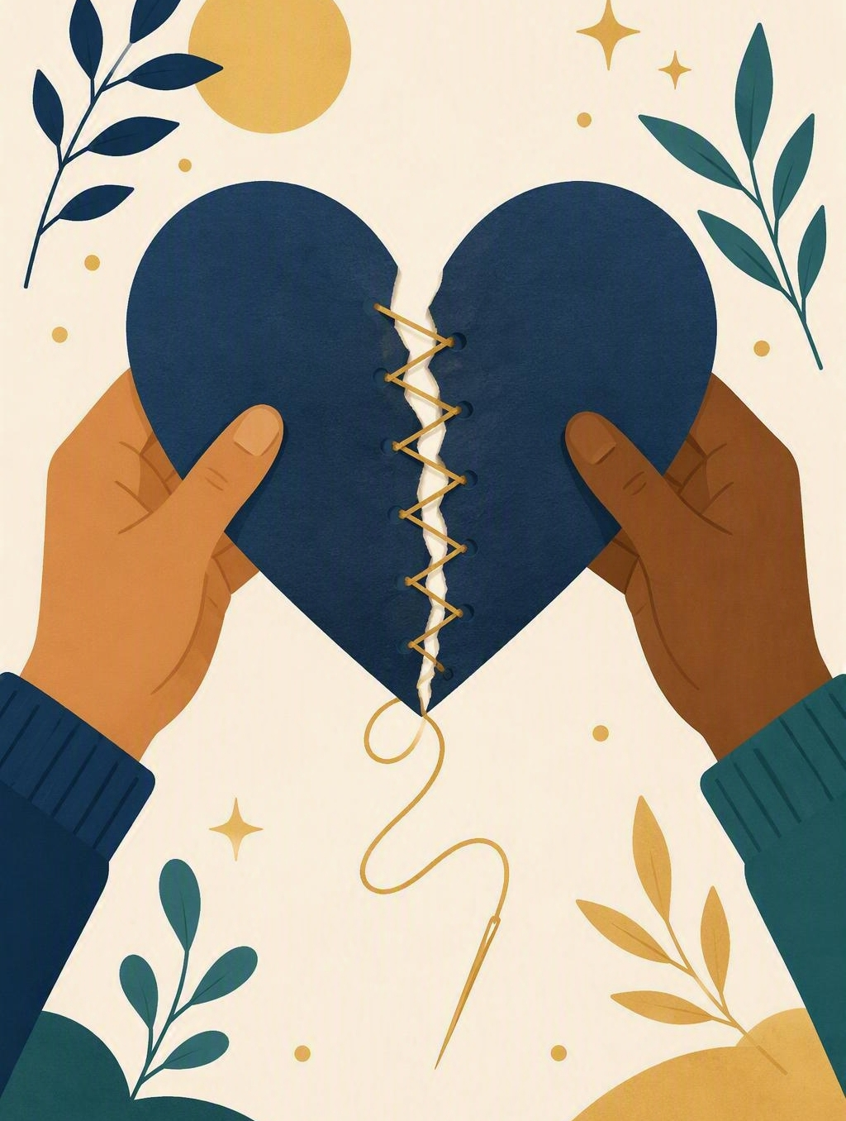
Repair a disagreement
FLOURISH · REDEMPTION
YEAR 6
Pause, hear, own, solve, check — five moves that mend a fall-out well.
#friendship
#digitallife
#humility
#peacemaking
Notes:
LEARNING INTENTION
• We are learning to repair a disagreement: pause, hear, own, solve and check.
SUCCESS CHECK
• I can choose repair words that own my part and offer a next move in the fictional case, and explain the choice.
KEY QUESTION
• What has to happen before ‘sorry’ counts – and what still has to happen after it?
NIV CONNECTION
• Matthew 5:23–24 – go and be reconciled first. Read Matthew 5:21–24 from the NIV in the Explore section.
CHRISTIAN FORMATION
• Christian peacemaking is neither pretending nothing happened nor waiting to be approached first. Grace goes first and also forms humility. ‘Sorry’ is truthful only when it is joined to owning, listening and a next repair move.
PREPARE IN UNDER 5 MINUTES
• Write three columns on the board: BLAME | OWN | NEXT MOVE. Have the six repair sentence cards ready.
RETRIEVAL BRIDGE
• Retrieve the Shalom compass. Ask: which direction includes mending peace with another person? Expected: others, connected with God and self.
RUN SHEET AT A GLANCE
• Connect – Explore – Practise – Reflect .
SAFEGUARDING
• No forced disclosure. Students may pass, write privately or use a fictional example. Keep every worked example school-based and safe; never ask a student to name a real fall-out aloud. Follow up any concerns privately using the school support pathway.
ACCESS / LOW-DISCLOSURE
• Read instructions aloud and display them. Allow silent pointing, writing or partner response. Provide extra processing time and a sentence frame. Never require eye contact, public role-play, prayer aloud or disclosure of personal distress.
OFFLINE FALLBACK
• Three board columns (BLAME | OWN | NEXT MOVE) plus six printed sentence cards, one set per group.
PARTICIPATION
• Students may pass, write privately or use a fictional example. Do not ask for personal disclosure; use the fictional scenario instead.

Slide 2
“It was only a joke.” Now pause. What did the other person actually feel?
CONNECT · One small pause
T3 · REPAIR A DISAGREEMENT · WEEK 6
You can always pass, write your answer privately, or use a made-up example.
CONNECT
EXPLORE
PRACTISE
REFLECT
Notes:
FICTIONAL SCENARIO · NOAH AND PRIYA’S GROUP CHAT
Read this aloud so students respond to the person in the story, not to their own lives. Nobody needs to share anything personal.
Noah and Priya usually sit together, but after a rushed message in the class group chat Priya felt laughed at and stopped replying. Noah says, “It was only a joke and she is overreacting.” Their teacher notes that the message went to twelve people, that Noah has not asked Priya how she felt, and that neither has spoken face to face since.
Questions for reflection
• Which words in Noah’s reply blame Priya instead of owning the message?
• What would Noah need to hear from Priya before any repair could start?
• What is the smallest first move Noah could actually make before tomorrow?
CONNECT
• Read it aloud: “What did the other person actually feel?”
• Restate the participation options aloud: pass, write privately, or use a fictional example.
TEACHING SCRIPT
• Write on the board: “It was only a joke.” Then ask for the one small move that has to come first: pause.
• Say: ‘Today we are learning to repair a disagreement – pause, hear, own, solve, check.’ Then ask the question on the slide: ‘What did the other person actually feel?’
TEACHING SCRIPT
• Looking for: the joke may have been meant lightly – the intention has not changed – but only the other person can say how it landed on them.
• Take two or three quick responses; no hands-up pressure. If the room is quiet, offer a starter: ‘Which words would you want to hear first if it were you?’
• Land the line and write it up: ‘Pause before you defend.’ Keep it visible – the whole lesson hangs on it.
FORMATIVE LOOK-FOR
• Students name both halves: the joke was meant lightly, and the hurt is still real. If they only say ‘she overreacted’, push once: ‘Is that owning it, or defending it?’
ACCESS
• Display the sentence as well as saying it. Allow pointing or writing instead of speaking; give extra processing time.
PARTICIPATION
• Students may pass, write privately or use a fictional example. Do not ask for personal disclosure; use the fictional scenario instead. Keep the board example about the story, not about anyone in the room.

Slide 3
Matthew 5:23–24
EXPLORE · Christian connection
T3 · REPAIR A DISAGREEMENT · WEEK 6
“If you are offering your gift at the altar and there remember that your brother or sister has something against you … be reconciled to them.”
Matthew 5:23–24, New International Version (NIV)
CHRISTIAN CONNECTION
Jesus tells people to stop mid-worship and go and mend what is broken with someone else. So repair is not just good manners — it is urgent, and it starts with owning your own part.
EXPLORE
CONNECT
PRACTISE
REFLECT
Notes:
EXPLORE
• Read Matthew 5:21–24 aloud from the NIV, in context, then leave 5:23–24 on the screen.
TEACHING SCRIPT
• Contrast two sentences on the board. Fake repair: ‘Sorry if you got upset.’ Real repair: ‘I sent that message and it hurt you. What would help now?’
• Ask: ‘Which one would you believe if it were said to you?’ Looking for: the second – it names the action and asks the other person what they need.
TEACHING SCRIPT
• Repair must be specific. Saying sorry again without changing anything is not repair – that is why ‘sorry’ needs owning, a solution and a way of checking later.
• Example to say aloud: sending five apology messages is not repair; asking to talk face to face, naming your own part and agreeing one fix is.
TEACHING SCRIPT
• Read Matthew 5:21–24 in context. Note that Jesus interrupts worship for reconciling, and says it to a whole community – repair here is shared work, not a private feeling.
• Land the connection on the slide: the hurt is real and mending it is urgent, so blaming the other person is not an option – and silence is not one either, because we are asked to go first.
• Formation note for you: Christian peacemaking is neither pretending nothing happened nor waiting to be approached. Grace goes first and also forms humility.
• Check understanding: ‘What makes a “sorry” real rather than just polite?’ Looking for: owning the action, hearing the hurt, and agreeing a next move. Keep answers general – no personal examples needed.
ACCESS
• Display the verse as well as reading it. Never require reading aloud or prayer aloud. Give extra processing time before questions.
PARTICIPATION
• Students may pass, write privately or use a fictional example.
• Do not ask for personal disclosure; use the fictional scenario instead.

Slide 4
Which of these sentences would actually help repair things?
PRACTISE · Blame to repair move
T3 · REPAIR A DISAGREEMENT · WEEK 6
In groups of three or four, read all six sentences.
Sort them into READY TO USE and NEEDS EDITING, then rewrite the ones that need it.
1
“Sorry if you got upset by it.”
2
“I hear that my message made you feel laughed at in front of everyone.”
3
“Can we check with each other on Friday that things feel okay again?”
4
“You are way too sensitive about a simple joke.”
5
“I sent it to twelve people without asking — that choice was mine to make.”
6
“Shall I post in the chat that the joke was mine and that it was unfair?”
Ask of each one: does it own the choice, and does it offer a next move?
PRACTISE
CONNECT
EXPLORE
REFLECT
Notes:
PRACTISE - RUN SHEET
• Activity: blame-to-repair workshop. Keep the three board columns visible: BLAME | OWN | NEXT MOVE.
• SET UP (30 sec)
• Groups of 3-4. Each group gets the six sentence cards (printed, or read from the screen). Say: “Four of these are ready to use. Two of them have a problem. Your job is to work out which two.”
• SORT (2 min)
• Groups sort all six into READY TO USE / NEEDS EDITING. Circulate and listen; do not correct yet.
THE FOUR THAT WORK
• 2. “I hear that my message made you feel laughed at in front of everyone.” Hears the hurt first.
• 3. “Can we check with each other on Friday that things feel okay again?” Checks back later.
• 5. “I sent it to twelve people without asking – that choice was mine to make.” Owns the choice.
• 6. “Shall I post in the chat that the joke was mine and that it was unfair?” Offers a real solution.
THE TWO THAT NEED EDITING - and why
• 1. “Sorry if you got upset by it.” Problem: an apology with an ‘if’, no owning and nothing to check – saying sorry again is not repair. Class rewrite might be: “I am sorry I posted that; at break I will say it to you and ask what would help.”
• 4. “You are way too sensitive about a simple joke.” Problem: blaming words – too sensitive, simple. It judges the other person instead of owning the message. Class rewrite might be: “I can see that my message hurt you, and I sent it.”
• If a group defends card 1 or 4, ask: “What exactly is being owned here?” and “How would you know the friendship felt mended?”
WORKSHOP THE SCENARIO
• Underline the blaming words in Noah’s reply: only, overreacting. Replace them with what Noah actually did, drawn from what the teacher noticed.
• Build an owning sentence that does not blame: “I sent that message to twelve people and it made you feel laughed at.”
• Choose a smallest first move: ask to talk at break, post one honest line in the chat, or simply listen without defending.
• Apply the three columns to one fictional statement: “She started it”; “Everyone was laughing anyway”; “It was just a group chat.”
MODEL RESPONSE
• “I hear that my message made you feel laughed at. I sent it to twelve people and that was my choice; at break I will post that the joke was mine, and on Friday I will check we are okay.”
FORMATIVE LOOK-FOR
• Students avoid blaming words and attach the apology to a realistic repair move.
ACCESS
• Read the cards aloud as well as displaying them. Allow silent pointing, writing, or a partner answering on a student’s behalf. Give extra processing time. No public role-play, no forced disclosure.
OFFLINE FALLBACK
• Six printed repair cards (wording above), one set per group, plus the three board columns.
PARTICIPATION
• Students may pass, write privately or use a fictional example. Do not ask for personal disclosure; use the fictional scenario instead.

Slide 5
“I will own … and my next move is …”
REFLECT · Reflection and action
T3 · REPAIR A DISAGREEMENT · WEEK 6
Write this one privately — you don't have to share it.
TAKEAWAY
Repair is real only when it names your part first.
REFLECT
CONNECT
EXPLORE
PRACTISE
Notes:
REFLECT
• Give students the private stem: “I will own …” Keep it silent and private – no sharing required.
TEACHING SCRIPT
• Private choice: students write one repair sentence for a safe school-based disagreement. Say clearly: choose something school-sized – not anything private or painful. A made-up example is fine.
TEACHING SCRIPT
• Add the exact time, place or person for the next move. Without one of those three, it is a wish, not a plan.
• Model the size of answer you want: “I will own talking over someone – at break tomorrow I will say so and ask what would help.” Small and doable beats impressive. Sharing is optional; students may say ‘pass’.
TEACHING SCRIPT
• Whisper or write the breath phrase: “God goes first in peace; I can make the next small move.”
• Close with the takeaway on the slide: Repair is real only when it names your part first. Offer a brief prayer, blessing or quiet pause according to school practice. Never require prayer aloud.
FORMATIVE LOOK-FOR
• Students avoid blaming words and attach the repair to a realistic next move with a time, place or person attached.
SAFEGUARDING
• Writing stays private and is not collected or read aloud. Follow up any concerns privately using the school support pathway.
ACCESS
• Display the stem as well as reading it. Drawing, a single word, or thinking in silence all count. Give extra processing time.
OFFLINE FALLBACK
• Stem and breath phrase written on the board; students use paper or a workbook page.
PARTICIPATION
• Students may pass, write privately or use a fictional example. Do not ask for personal disclosure; use the fictional scenario instead.

