Slide 1
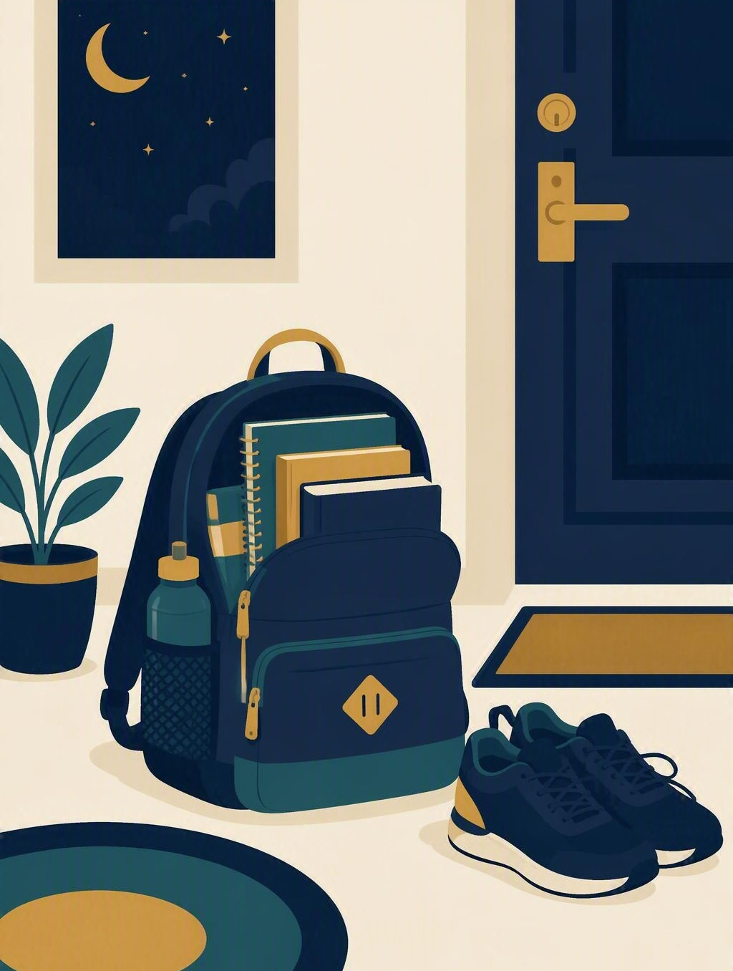
Ready the night before
FLOURISH · CREATION
YEAR 6
A two-minute checklist that makes tomorrow morning calmer.
#independence
#wisdom
#self-control
#preparation
Notes:
WEEK 2 · READY THE NIGHT BEFORE
LEARNING INTENTION
• We are learning to build a two-minute checklist we can run the night before so tomorrow starts calmly.
SUCCESS CHECK
• I can choose three night-before actions, put them in a two-minute order, and explain why each one helps.
NIV CONNECTION
• Proverbs 21:5 – steady planning beats last-minute haste.
CHRISTIAN FORMATION
• Creation: humans are made to work, rest and order their time. Wisdom literature treats forethought as a form of faithfulness, not anxiety. Preparing well is ordinary discipleship: it frees us from panic and makes us dependable for other people.
• CSA alignment: Formation / Becoming; Spirituality / Expressing.
RETRIEVAL BRIDGE
• Ask: “Which Flourish norm lets a person take part without talking about home?” Expected: private, pass or fictional.
PREPARE IN UNDER 5 MINUTES
• Draw a two-column board chart: NIGHT-BEFORE ACTION | WHY IT HELPS. Have paper ready for a private checklist.
SAFEGUARDING
• No forced disclosure. Students may pass, write privately or use a fictional example. Home routines vary widely and some students have little control over their evenings – never imply a rushed morning is a personal failing. Follow up any concerns privately using the school support pathway.
ACCESS / LOW-DISCLOSURE
• Read instructions aloud and display them. Allow silent pointing, writing or partner response. Offer the six checklist cards so students can choose rather than generate. Provide extra processing time. Never require eye contact, public role-play, prayer aloud or disclosure of home circumstances.
OFFLINE FALLBACK
• Board chart plus printed checklist cards and the scenario read aloud; no screen required.
PARTICIPATION
• Students may pass, write privately or use a fictional example. No forced disclosure. Do not ask students to describe their home routines aloud; the fictional case carries the thinking.

Slide 2
What makes a morning feel calm before it has even started?
CONNECT · The morning scramble
T4 · READY THE NIGHT BEFORE · WEEK 2
You can always pass, write your answer privately, or use a made-up example.
CONNECT
EXPLORE
PRACTISE
REFLECT
Notes:
FICTIONAL SCENARIO · JAMIE’S SCRAMBLED MORNINGS
Read this aloud so students respond to the person in the story, not to their own lives. Nobody needs to share anything personal.
Jamie’s mornings are a scramble – hunting for a library book, a missing sports shirt, a note that still needs signing. On Tuesday night Jamie spends two minutes with the timetable, packs the bag, fills the drink bottle and puts shoes by the door. On Wednesday morning Jamie walks out calmly, on time, with enough space to say hello at the gate.
Questions for reflection
• What exactly did Jamie do the night before?
• Which of those two minutes made the biggest difference?
• Who else benefits when one person is ready on time?
CONNECT
• Read it aloud: “What makes a morning feel calm before it has even started?”
TEACHING SCRIPT
• Name one small night-before action: “Putting your bag by the door tonight is a two-minute decision that changes tomorrow morning.”
• Say: “Today we are learning to build a two-minute checklist we can run the night before.”
TEACHING SCRIPT
• Students silently picture tomorrow – timetable, kit, homework, food, sleep – and choose one thing worth doing tonight.
• Prompt if the room is quiet: “Think of a morning that felt rushed. What one thing, done the night before, would have fixed it?” Take two or three quick responses – no hands-up pressure.
MODEL RESPONSE
• Rushed morning: “I could not find my library book.” Night-before action: put the book in the bag straight after dinner.
FORMATIVE LOOK-FOR
• Students name a specific action and when they will do it, rather than a vague promise to try harder.
PARTICIPATION
• Students may pass, write privately or use a fictional example. No forced disclosure. Do not ask students to describe their home routines aloud; the fictional case carries the thinking.
ACCESS
• Display the five checklist areas in writing; allow students to point or write instead of speaking.
OFFLINE FALLBACK
• Write the five checklist areas on the board and take responses on paper.

Slide 3
Proverbs 21:5
EXPLORE · Christian connection
T4 · READY THE NIGHT BEFORE · WEEK 2
“The plans of the diligent lead to profit as surely as haste leads to poverty.”
Proverbs 21:5, New International Version (NIV)
CHRISTIAN CONNECTION
Planning ahead is a quiet kind of care. Getting ready the night before is not worrying about tomorrow; it steadies us so we can be on time and available to others.
EXPLORE
CONNECT
PRACTISE
REFLECT
Notes:
EXPLORE
TEACHING SCRIPT
• Explain: being ready is a set of small, repeatable actions, not a personality type. A checklist is a plan you can see, so it does not rely on remembering at 7:45am.
TEACHING SCRIPT
• Correct two errors: “Planning is for anxious people” and “I work better under pressure, so I’ll do it in the morning.” Both trade two calm minutes for ten frantic ones.
• Keep this brisk and impersonal – name the two errors as ideas, not as anyone in the room.
TEACHING SCRIPT
• Read Proverbs 21:5 from the NIV. Ask students to listen for the contrast between steady planning and haste.
• State: forethought is a form of faithfulness – it is care for tomorrow’s self and for the people who are counting on us.
CHRISTIAN FORMATION
• Creation: humans are made to work, rest and order their time. Wisdom literature treats forethought as faithfulness rather than anxiety. Preparing well is ordinary discipleship: it frees us from panic and makes us dependable for other people.
MODEL RESPONSE
• “The proverb says plans lead to profit and haste leads to loss – so the two minutes tonight are not fussing, they are the thing that saves the morning.”
FORMATIVE LOOK-FOR
• Students describe planning as steady care rather than as worry or fussiness.
PARTICIPATION
• Students may pass, write privately or use a fictional example. No forced disclosure. Do not ask students to describe their home routines aloud; the fictional case carries the thinking.
ACCESS
• Display the verse as well as reading it. Reading aloud is invited, never required. No prayer aloud is required.
OFFLINE FALLBACK
• Read Proverbs 21:5 from a printed Bible or handout.

Slide 4
What can we actually do the night before?
PRACTISE · Two-minute checklist
T4 · READY THE NIGHT BEFORE · WEEK 2
Sort the cards into real actions and wishful thinking.
Choose your three, then write them in a two-minute order.
1
Hoped the sports uniform would turn up
2
Filled the drink bottle and set an alarm
3
Decided mornings are just always chaotic
4
Left it all to sort out in the morning
5
Checked tomorrow’s timetable for sport
6
Packed the library book by the front door
Test each card: could you finish it tonight in under two minutes?
PRACTISE
CONNECT
EXPLORE
REFLECT
Notes:
PRACTISE · RUN SHEET
• Activity: Build the two-minute checklist. Use the board chart: NIGHT-BEFORE ACTION | WHY IT HELPS.
• Students sort the six cards into real night-before actions and wishful thinking.
• Beside each real action, write why it helps: saves time, avoids forgetting, lowers stress or helps someone else.
• Choose the three that matter most tomorrow. Example: sport day tomorrow, so the shirt comes first. Students write their three in the order they would do them.
• Pairs compare one checklist and test it: Could you really finish all three in two minutes? Is each step specific enough to do without thinking?
MODEL RESPONSE
• Real actions: Jamie checked the timetable, packed the bag by the door and filled the drink bottle.
• Why they help: they remove the three decisions that used to happen in a rush.
• Two-minute order: “Check timetable, pack bag, put bag and shoes by the door – always in that order, straight after dinner.”
SORTING THE CARDS – TEACHER ANSWERS
• Real night-before actions (cards 2, 5, 6): filled the drink bottle and set an alarm; checked tomorrow’s timetable for sport; packed the library book by the front door.
• Wishful thinking (cards 1, 3, 4): “Hoped the sports uniform would turn up”; “Decided mornings are just always chaotic”; “Left it all to sort out in the morning.”
• Do not reveal the sort before students attempt it.
FORMATIVE LOOK-FOR
• Students choose specific, doable actions and can say why each one helps tomorrow.
PARTICIPATION
• Students may pass, write privately or use a fictional example. No forced disclosure. Do not ask students to describe their home routines aloud; the fictional case carries the thinking.
ACCESS
• Provide the six checklist cards in print. Allow pointing, writing or partner response. Pairs may be silent and written.
OFFLINE FALLBACK
• Printed scenario card, six checklist cards and the two-column board chart.

Slide 5
“Tonight my two minutes will be …”
REFLECT · Reflection and action
T4 · READY THE NIGHT BEFORE · WEEK 2
Write this one privately — you don't have to share it.
TAKEAWAY
Two calm minutes tonight buy back ten frantic ones tomorrow.
REFLECT
CONNECT
EXPLORE
PRACTISE
Notes:
REFLECT
• Private reflection: write the three actions of your own two-minute checklist, in the order you would do them.
• Add one sentence: “Tonight my two minutes will be ____, and it will help because ____.” Students need not share.
• Optional prayer: “God of order and peace, give us the wisdom to prepare and the calm to begin again tomorrow. Amen.” Joining in is invited, never required.
MODEL RESPONSE
• “Check the timetable, pack my bag, put it by the door. Tonight my two minutes will be packing my bag after dinner, and it will help because I stop losing my reader in the morning.”
FORMATIVE LOOK-FOR
• Students choose specific, doable actions and can say why each one helps tomorrow.
SUCCESS CHECK
• I can choose three night-before actions, put them in a two-minute order, and explain why each one helps.
PARTICIPATION
• Students may pass, write privately or use a fictional example. No forced disclosure. Do not ask students to describe their home routines aloud; the fictional case carries the thinking.
SAFEGUARDING
• Do not collect or read these reflections aloud. Some students have little control over their evenings; keep the task about one small action, not the whole household. If a student writes something concerning, follow up privately using the school support pathway.
ACCESS
• Display the sentence stem. Allow drawing, dictation or extra processing time.
OFFLINE FALLBACK
• Sentence stem written on the board; students write on paper.

