Slide 1
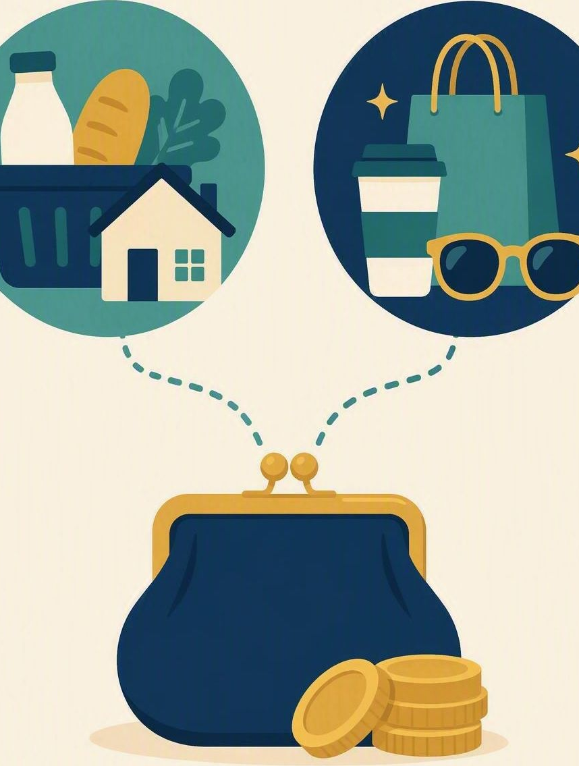
Needs, wants and choices
FLOURISH · CREATION
YEAR 6
Making a simple spending choice when the money is limited.
#money
#choices
#planning
#stewardship
Notes:
WEEK 4 · NEEDS, WANTS AND CHOICES · YEAR 6 TERM 4
• #money – character focus: self-control and stewardship. Term 4 READY: independence and transition. CSA alignment: Formation / Becoming; Spirituality / Expressing.
LEARNING INTENTION
• We are learning to tell needs from wants and to make a simple spending choice with limited money.
SUCCESS CHECK
• I can sort items into needs and wants in the fictional case, decide what Nia pays for first, and explain why.
RETRIEVAL BRIDGE
• Retrieve from Week 3: a plan works best when it is small, specific and checked before you act.
PREPARE IN UNDER 5 MINUTES
• Draw three small boxes: NEED | WANT | IN BETWEEN.
• Have ten £1 coin counters (or paper circles) ready to model Nia’s £10 – no real money from students.
NIV CONNECTION
• 1 Timothy 6:6–8 – godliness with contentment is great gain; food and clothing as needs.
CHRISTIAN FORMATION
• Money is a good gift to be stewarded, not a measure of worth. Paul names food and clothing as needs and calls contentment “great gain”, so wants can be enjoyed but do not command us. Never imply that having less money means being less faithful.
SAFEGUARDING
• No forced disclosure. Students may pass, write privately or use a fictional example. Keep all work on Nia, never on a family’s real income, debts or spending. Do not ask what students own, receive as pocket money, or cannot afford. Follow up any concerns privately using the school support pathway.
ACCESS / LOW-DISCLOSURE
• Read instructions aloud and display them. Allow silent pointing, writing or partner response. Provide extra processing time. Keep the sums simple and allow counters or a number line. Never require eye contact, public role-play, prayer aloud, or disclosure of family finances.
OFFLINE FALLBACK
• Three drawn boxes (NEED | WANT | IN BETWEEN) plus six printed item cards and ten paper coins; read the cards aloud.

Slide 2
Nia has £10 saved. What should she pay for first, and why?
CONNECT · A simple spending choice
T4 · NEEDS, WANTS AND CHOICES · WEEK 4
You can always pass, write your answer privately, or use a made-up example.
CONNECT
EXPLORE
PRACTISE
REFLECT
Notes:
FICTIONAL SCENARIO · NIA’S TEN POUNDS
Read this aloud so students respond to the person in the story, not to their own lives. Nobody needs to share anything personal.
Nia has £10 saved in a tin. On Friday she owes £4 for the class trip snack, and she needs £1 bus fare home from club. On the way home she sees a phone case she really likes for £9. Her friend says, ‘Just buy it now – you can sort the rest out later.’
Questions for reflection
• Which of Nia’s costs are needs, and which are wants?
• What happens on Friday if she spends £9 on the phone case today?
• How could Nia still get the phone case without missing what she needs?
CONNECT
• Read it aloud: “Nia has £10 saved. What should she pay for first, and why?”
• Restate the participation options aloud: pass, write privately, or use a fictional example.
TEACHING SCRIPT
• Lay out ten coin counters. Say: ‘This is Nia’s £10. Today we are learning to tell needs from wants and to make one spending choice on purpose.’
• Ask: ‘Nia has £10 saved. What should she pay for first, and why?’ Take two or three quick responses – no hands-up pressure.
• Model answer to land: the £4 trip snack and the £1 bus fare come first, because they are already owed and needed; that leaves £5, which is not yet enough for the £9 case.
• Do not ask students what they own or receive. Keep every example on Nia.
TEACHING SCRIPT
• Say the word bank aloud and have students sort items back: food, bus fare, school shoes, a game, a gift, a phone case.
• Keep the language neutral: wants are not bad and needs are not boring. Redirect any ‘that family is poor’ or ‘that’s cheap’ comments back to the item on the card.
• Retrieval bridge from Week 3: a good plan is small, specific and checked before you act. ‘Pay the £4 on Friday’ is a plan; ‘I’ll sort it later’ is not.
FORMATIVE LOOK-FOR
• Students name an item as a need or a want and give a reason, rather than judging the person who buys it.
PARTICIPATION
• Students may pass, write privately or use a fictional example. Do not ask for personal disclosure; use the fictional scenario instead.

Slide 3
1 Timothy 6:6–8
EXPLORE · Christian connection
T4 · NEEDS, WANTS AND CHOICES · WEEK 4
“But godliness with contentment is great gain. For we brought nothing into the world, and we can take nothing out of it. But if we have food and clothing, we will be content with that.”
1 Timothy 6:6–8, New International Version (NIV)
CHRISTIAN CONNECTION
Paul names food and clothing as needs, and calls contentment “great gain”. Wise stewardship means paying for what we need first, then choosing about wants on purpose rather than by impulse.
EXPLORE
CONNECT
PRACTISE
REFLECT
Notes:
EXPLORE
• Read 1 Timothy 6:6–8 aloud from the NIV, in context.
• Connect the passage to the skill: Paul names food and clothing as needs and calls contentment “great gain” – needs first, then wants chosen freely.
TEACHING SCRIPT
• Explain the sequence: money in → needs first – what is owed or required → what is left → a want chosen on purpose.
• A want often shouts louder than a need because we can see it. Naming the needs first buys us time to decide.
TEACHING SCRIPT
• Correct the misconception “Wanting something means I should buy it.” A strong want invites a pause; it does not decide what the money does.
• Check understanding: ‘Nia has £10 and £5 of costs already owed. What can the other £5 do, and what can it not do yet?’
• Looking for: £5 can start saving towards the £9 case or buy a smaller gift; it cannot cover the case today without breaking a promise.
TEACHING SCRIPT
• Read 1 Timothy 6:6–8 from the NIV. Ask: ‘What does Paul call a need, and what does he call gain?’
• Model response: food and clothing are named as needs; the “great gain” is godliness with contentment – being at peace rather than always needing the next thing.
• Land the Christian formation point: money is a good gift to steward, not a measure of a person’s worth. Wants can be enjoyed, but contentment means they do not run the choice.
• Keep it general: no family income or personal spending examples needed or invited.
FORMATIVE LOOK-FOR
• Students can state the sequence money in → needs → what is left → want, and can say that wanting something does not decide the choice.
PARTICIPATION
• Students may pass, write privately or use a fictional example. Do not ask for personal disclosure; use the fictional scenario instead.

Slide 4
Where does each item belong: need, want or in between?
PRACTISE · Nia’s spending sort
T4 · NEEDS, WANTS AND CHOICES · WEEK 4
Sort all six items into NEED, WANT or IN BETWEEN.
Draw an arrow from Nia’s £10 to what she pays for first.
1
Bus fare home from club
2
Trip snack money, due Friday
3
A birthday gift for her cousin
4
School shoes with a hole in them
5
A phone case she really likes
6
A new game for her tablet
More than one placement can work — be ready to explain your reasoning.
PRACTISE
CONNECT
EXPLORE
REFLECT
Notes:
MODEL RESPONSE
• ‘Nia needs the £4 snack money and the £1 fare first, so £5 is left. Wanting the case is fine, but it is not a need. She can save £2 a week and buy it in two weeks.’
FORMATIVE LOOK-FOR
• Students pay a need first, give a reason for their sort, and check what money is left before choosing a want.
ACCESS
• Read the cards aloud as well as displaying them. Allow silent pointing, writing, or a partner answering on a student’s behalf. Give extra processing time and allow coins or a number line for the subtraction. No public role-play, no questions about family money.
OFFLINE FALLBACK
• Three drawn boxes plus six printed item cards (wording on the slide) and ten paper coins, one set per group.

Slide 5
“One thing I will check before I spend is …”
REFLECT · One spending choice
T4 · NEEDS, WANTS AND CHOICES · WEEK 4
Write this one privately — you don't have to share it.
TAKEAWAY
Pay for what you need first, then choose a want on purpose.
REFLECT
CONNECT
EXPLORE
PRACTISE
Notes:
REFLECT
• Give students the private stem: “One thing I will check before I spend is …” Keep it silent and private – no sharing required.
• Close with a short prayer, blessing or silent reflection appropriate to the class. Never require prayer aloud.
• Follow up any concerns privately using the school support pathway. Never comment on what a student’s family can or cannot afford.
TEACHING SCRIPT
• Students privately select one item from Nia’s sort and match it to one check they could make before spending.
• Model the size of answer you want: ‘phone case → ask, do I owe anything this week first?’, or ‘new game → wait a week and see if I still want it’. Small and doable beats impressive. Sharing is optional; students may say ‘pass’.
TEACHING SCRIPT
• Students sketch a small tick beside the item Nia pays for first – the need that is already owed.
• Look-for: the tick sits on a need such as the £4 snack money, not on the phone case.
TEACHING SCRIPT
• Close with the takeaway on the slide: ‘Pay for what you need first, then choose a want on purpose.’
• Offer a brief prayer, blessing or quiet pause according to school practice, linking back to godliness with contentment being great gain.
FORMATIVE LOOK-FOR
• Students name a need they would pay first and one check they would make before buying a want.
PARTICIPATION
• Students may pass, write privately or use a fictional example. Do not ask for personal disclosure; use the fictional scenario instead.

