Slide 1
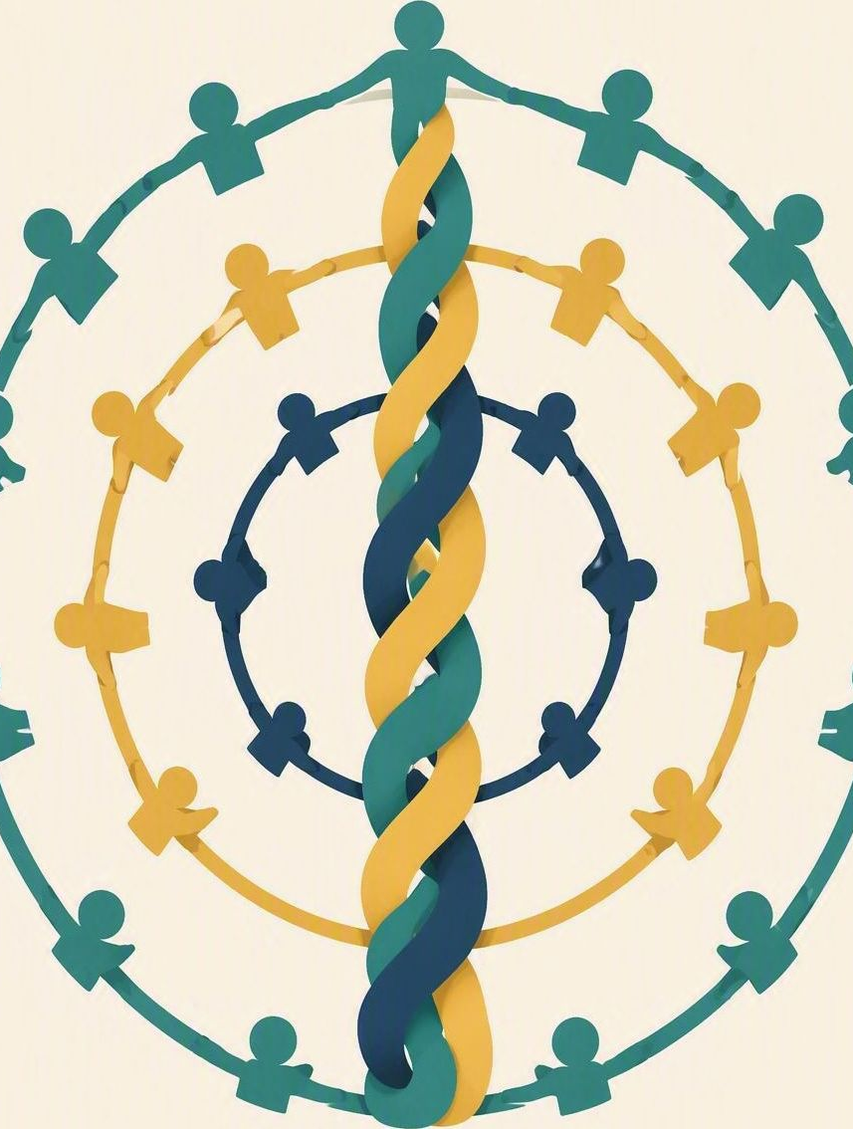
My support team
FLOURISH · RESTORATION
YEAR 6
Mapping the trusted adults and peers who can help you.
#helpseeking
#lifeskills
#compassion
#safety
Notes:
WEEK 10 · MY SUPPORT TEAM
• Year 6 · Term 1 · #helpseeking #lifeskills · Character focus: compassion and kindness.
LEARNING INTENTION
• We are learning to map trusted adults and peers for school, home and community.
SUCCESS CHECK
• I can map trusted adults and peers for school, home and community in the fictional case, and explain the choice.
KEY QUESTION
• Who is on your support team, and what happens if your first person is unavailable?
NIV CONNECTION
• Ecclesiastes 4:9–10 – people help one another rise after a fall.
CHRISTIAN FORMATION
• God often gives help through other people and communities. Interdependence is not failure.
• A peer can notice, stay and accompany; adults carry the responsibility for assessment, protection and referral.
• Trust is based on role and demonstrated action, not popularity alone.
CSA ALIGNMENT
• Family / Bonding; Relationships / Belonging; Spirituality / Expressing.
RETRIEVAL BRIDGE
• Retrieve the Week 1 PROTECT norm and Week 9’s idea of bounded responsibility. Ask: what can a peer do, and what belongs to an adult?
PREPARE IN UNDER 5 MINUTES
• Draw three concentric circles labelled FIRST CONTACT / BACK-UP / URGENT–EMERGENCY. Leave blanks for your school’s named roles, and confirm who your designated adult is before you teach.
SAFEGUARDING
• Privacy is not the same as secrecy. Privacy never means keeping a safety risk secret. Never promise to keep a safety or wellbeing concern secret, and say so before students write any response.
• Concerns go to the school’s designated adult. Follow up any concern privately using the school support pathway; call 000 if there is immediate danger or serious injury.
• No forced disclosure. Students may pass, write privately or use the fictional scenario. Keep shared examples fictional and use roles rather than names.
ACCESS / LOW-DISCLOSURE
• Read instructions aloud and display them. Allow silent pointing, writing or a partner response, and give extra processing time. Never require eye contact, public role-play, prayer aloud or disclosure of personal distress.
OFFLINE FALLBACK
• Printed three-ring support map plus the six response cards, one set per group. No devices required.

Slide 2
Who would you go to first – and who is your back-up?
CONNECT · First and back-up
T1 · MY SUPPORT TEAM · WEEK 10
You can always pass, write your answer privately, or use a made-up example.
CONNECT
EXPLORE
PRACTISE
REFLECT
Notes:
FICTIONAL SCENARIO · LUNCHTIME WORRY
Read this aloud so students respond to the people in the story, not to their own lives. Nobody needs to share anything personal.
During lunch, Chris says to Pat, “I have been worried all week and I can’t concentrate. Don’t tell anyone – I only trust you.” Pat wants to help, but knows this is affecting Chris’s daily life. The classroom teacher is on duty, the wellbeing office is open after lunch, and a caregiver can be contacted after school.
Questions for reflection
• Which adults are actually available to Pat right now?
• What can Pat do, and what belongs to an adult?
• What should Pat do if the first person is unavailable?
CONNECT
• Read it aloud: “Who would you go to first – and who is your back-up?”
• Restate the participation options: pass, write privately, or answer using a role instead of a name.
TEACHING SCRIPT
• Say: “One person does not need to solve every problem. A strong support map has more than one route.”
• Say: “Today we are mapping the people who can help – at school, at home and in the community.”
TEACHING SCRIPT
• Students silently list roles, not private problems. Prompt the categories if the room is quiet: classroom teacher, caregiver, wellbeing staff, coach, youth leader, office staff, emergency service.
• Take two or three quick responses – no hands-up pressure. Redirect at once if a student begins naming a private problem: “Just the role, thanks – not the story.”
MODEL RESPONSE
• “My first contact is the classroom teacher, my back-up is the wellbeing office, and my urgent route is 000.”
FORMATIVE LOOK-FOR
• Students name roles rather than problems, and offer more than one route.
PARTICIPATION
• Students may pass, write privately or name a role instead of a person. Do not ask for personal disclosure; use the fictional scenario instead.
SAFEGUARDING
• Privacy is not the same as secrecy. Privacy never means keeping a safety risk secret. Never promise to keep a safety or wellbeing concern secret, and say so before students write any response.
• Concerns go to the school’s designated adult. Follow up any concern privately using the school support pathway; call 000 if there is immediate danger or serious injury.
• No forced disclosure. Students may pass, write privately or use the fictional scenario. Keep shared examples fictional and use roles rather than names.
ACCESS / LOW-DISCLOSURE
• Read instructions aloud and display them. Allow silent pointing, writing or a partner response, and give extra processing time. Never require eye contact, public role-play, prayer aloud or disclosure of personal distress.

Slide 3
Ecclesiastes 4:9–10
EXPLORE · Christian connection
T1 · MY SUPPORT TEAM · WEEK 10
“Two are better than one, because they have a good return for their labor: If either of them falls down, one can help the other up. But pity anyone who falls and has no one to help them up.”
Ecclesiastes 4:9–10, New International Version (NIV)
CHRISTIAN CONNECTION
God often gives help through other people, so needing others is not failure. A friend can notice and stay with you, while adults carry the responsibility to protect and act.
EXPLORE
CONNECT
PRACTISE
REFLECT
Notes:
EXPLORE
• Read Ecclesiastes 4:9–12 aloud from the NIV, in context. Note mutual support and the wisdom of more than one strand.
TEACHING SCRIPT
• Teach three qualities of a useful support person: available (you can actually reach them), responsible for helping (it is part of their role), and willing to act rather than merely keep a secret.
• Check understanding: “Which of those three is easiest to get wrong when we choose someone?” Looking for: willingness to act – someone who only promises secrecy is not a support person.
TEACHING SCRIPT
• Clarify the peer role: listen briefly, stay with the person, and connect them to an adult. A peer is never the only safety plan.
• Name the boundary out loud: a peer is not the counsellor and does not carry assessment, protection or referral. Adults carry that.
TEACHING SCRIPT
• Read the passage in context. It is wisdom writing about shared work and shared risk, not a proof text about friendship.
• Land the connection on the slide: God often gives help through other people. Needing others is not failure – it is how we are made to live.
• Make it concrete: a cord of three strands is stronger than one, so a support map with three routes still holds when one route is unavailable.
MODEL RESPONSE
• “A good support person is someone I can actually reach, whose role it is to help, and who will do something rather than just promise to say nothing.”
FORMATIVE LOOK-FOR
• Students distinguish the peer role (notice, stay, connect) from the adult role (assess, protect, refer).
PARTICIPATION
• Students may pass, write privately or use a made-up example. Keep answers general.
SAFEGUARDING
• Privacy is not the same as secrecy. Privacy never means keeping a safety risk secret. Never promise to keep a safety or wellbeing concern secret, and say so before students write any response.
• Concerns go to the school’s designated adult. Follow up any concern privately using the school support pathway; call 000 if there is immediate danger or serious injury.
• No forced disclosure. Students may pass, write privately or use the fictional scenario. Keep shared examples fictional and use roles rather than names.
ACCESS / LOW-DISCLOSURE
• Read instructions aloud and display them. Allow silent pointing, writing or a partner response, and give extra processing time. Never require eye contact, public role-play, prayer aloud or disclosure of personal distress.

Slide 4
What should Pat say, and who should they go to?
PRACTISE · Build a support map
T1 · MY SUPPORT TEAM · WEEK 10
Place the available roles into first contact, back-up and urgent rings.
Sort the six cards: which would help Pat, and which need editing?
1
“Just tell me everything – I can sort this out myself.”
2
“If they’re busy, we can go to the wellbeing office after lunch.”
3
“I can’t promise to keep this secret, but I will stay with you.”
4
“I promise I won’t tell a single person, ever.”
5
“I’m glad you told me – that took courage.”
6
“I’ll walk with you to the teacher on duty now.”
Use the fictional story only. Ask of each card: could you actually keep that promise?
PRACTISE
CONNECT
EXPLORE
REFLECT
Notes:
PRACTISE · RUN SHEET
• Activity: three-ring support map. Groups of 3–4. Each group gets the six response cards (printed, or read from the screen).
• Say: “Four of these are things a good support person would say. Two would make the situation less safe. Work out which two.”
BUILD THE MAP
• Students place the available roles into the three rings: FIRST CONTACT, BACK-UP, URGENT–EMERGENCY. Explain that the same adult may appear in more than one ring depending on urgency.
WRITE PAT’S FIRST RESPONSE
• Three parts required: appreciate the telling; do not promise secrecy; name the next adult. Circulate and listen; do not correct yet.
BACK-UP AND EMERGENCY
• Add a back-up route in case the first person is unavailable.
• Then add the emergency rule: stay with the person and call 000 when immediate danger or serious injury is present.
ROUTE CHECK
• Pairs check each other’s route using only fictional details: Is an adult named? Is there a back-up? Does the peer avoid becoming the counsellor?
THE FOUR THAT WORK
• 2. “If they’re busy, we can go to the wellbeing office after lunch.” Supplies the back-up route.
• 3. “I can’t promise to keep this secret, but I will stay with you.” Refuses secrecy honestly and still offers presence.
• 5. “I’m glad you told me – that took courage.” Appreciates the telling without taking over.
• 6. “I’ll walk with you to the teacher on duty now.” Names the next adult and accompanies, rather than reporting from a distance.
THE TWO THAT NEED EDITING – and why
• 1. “Just tell me everything – I can sort this out myself.” Problem: the peer becomes the counsellor and the only safety plan. Rewrite might be: “I’ll listen and stay with you, and then we’ll go to someone whose job it is to help.”
• 4. “I promise I won’t tell a single person, ever.” Problem: it promises secrecy that cannot be kept when wellbeing or safety is affected. Rewrite might be: “I’ll keep this private, but if you’re not safe I have to tell an adult who can help.”
• If a group defends card 1 or 4, ask: “Is that a promise you could actually keep?” and “What happens on the day you are away?”
MODEL RESPONSE
• “I’m glad you told me. I can’t promise to keep something secret when it is affecting your safety or wellbeing. I will walk with you to the teacher on duty; if they are unavailable, we will go to the wellbeing office.”
FORMATIVE LOOK-FOR
• Students build a multi-route support map and refuse secrecy when wellbeing or safety is involved.
SAFEGUARDING
• Privacy is not the same as secrecy. Privacy never means keeping a safety risk secret. Never promise to keep a safety or wellbeing concern secret, and say so before students write any response.
• Concerns go to the school’s designated adult. Follow up any concern privately using the school support pathway; call 000 if there is immediate danger or serious injury.
• No forced disclosure. Students may pass, write privately or use the fictional scenario. Keep shared examples fictional and use roles rather than names.
ACCESS / LOW-DISCLOSURE
• Read instructions aloud and display them. Allow silent pointing, writing or a partner response, and give extra processing time. Never require eye contact, public role-play, prayer aloud or disclosure of personal distress.
OFFLINE FALLBACK
• Six printed response cards (wording above) and a printed three-ring map, one set per group.

Slide 5
“If my first person is unavailable, I can …”
REFLECT · Reflection and action
T1 · MY SUPPORT TEAM · WEEK 10
Write this one privately — you don't have to share it.
TAKEAWAY
A strong support team always has more than one route.
REFLECT
CONNECT
EXPLORE
PRACTISE
Notes:
REFLECT
• Give students the private stem: “If my first person is unavailable, I can …” Keep it silent and private – no sharing required.
TEACHING SCRIPT
• Students complete a private map with at least two adults and one back-up route. They may use roles instead of names.
• Model the size of answer you want: “My first contact is my class teacher; my back-up is the wellbeing office.” Roles are enough – nobody writes a problem down.
TEACHING SCRIPT
• Exit line: “If my first person is unavailable, I can ____.” Students write it privately; sharing is optional and students may say “pass”.
TEACHING SCRIPT
• Close by naming the school’s actual help route – the real roles and the real office – so the map is not hypothetical.
• Remind students that immediate danger requires urgent adult help or 000. Offer a brief prayer, blessing or quiet pause according to school practice. Never require prayer aloud.
MODEL RESPONSE
• “If my first person is unavailable, I can go to the wellbeing office, and if it is urgent I can call 000.”
FORMATIVE LOOK-FOR
• Every private map names at least two adults and one back-up route, and the student can explain why those people were chosen.
PARTICIPATION
• Students may pass, write privately or name a role instead of a person. Do not ask for personal disclosure; use the fictional scenario instead.
SAFEGUARDING
• Privacy is not the same as secrecy. Privacy never means keeping a safety risk secret. Never promise to keep a safety or wellbeing concern secret, and say so before students write any response.
• Concerns go to the school’s designated adult. Follow up any concern privately using the school support pathway; call 000 if there is immediate danger or serious injury.
• No forced disclosure. Students may pass, write privately or use the fictional scenario. Keep shared examples fictional and use roles rather than names.
ACCESS / LOW-DISCLOSURE
• Read instructions aloud and display them. Allow silent pointing, writing or a partner response, and give extra processing time. Never require eye contact, public role-play, prayer aloud or disclosure of personal distress.

