Slide 1
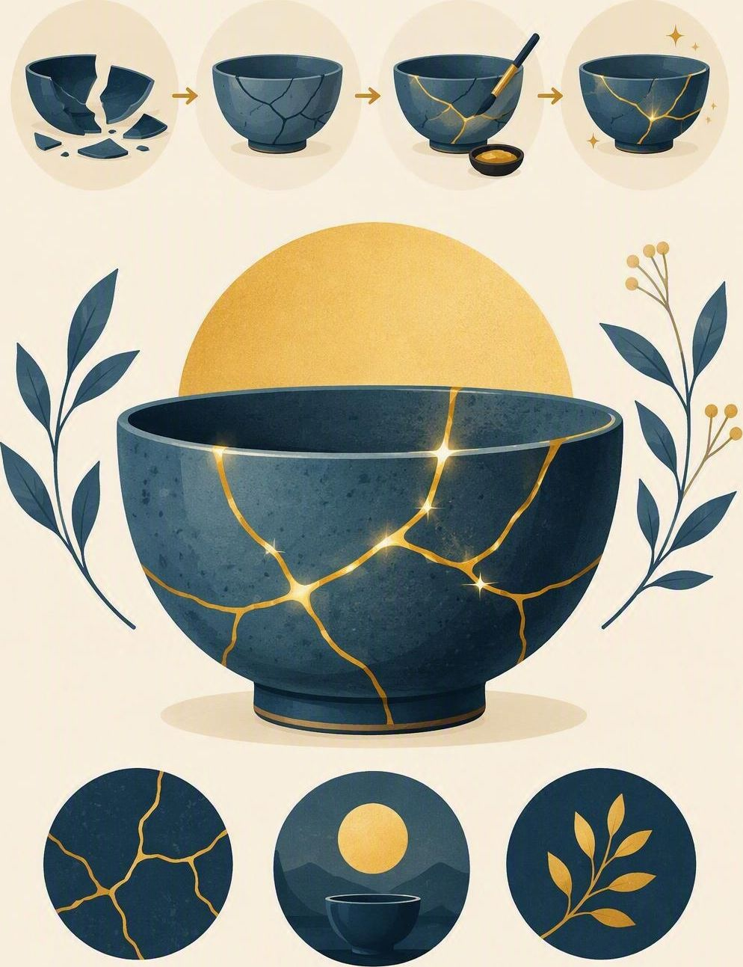
Mistakes and repair
FLOURISH · REDEMPTION
YEAR 6
Admit it, apologise well, repair what you can, and try again.
#repair
#lifeskills
#wisdom
#faithfulness
Notes:
LEARNING INTENTION
• We are learning to admit a mistake, apologise without excuses, and repair the harm.
SUCCESS CHECK
• I can turn a weak apology into a real one in the fictional case, and name the repair step.
KEY QUESTION
• What makes an apology real – and what still has to happen after the words?
NIV CONNECTION
• Proverbs 28:13 – concealing sin hides us from mercy. Read Proverbs 28:13 from the NIV in the Explore section.
CHRISTIAN FORMATION
• Christian confession is not grovelling and not excusing. Mercy comes before we deserve it, and it forms honesty in us. Sorry is truthful only when it is joined to ownership, repair and a changed next step.
PREPARE IN UNDER 5 MINUTES
• Write four columns on the board: ADMIT | APOLOGISE | REPAIR | RETRY. Have the six sentence cards ready.
RETRIEVAL BRIDGE
• Retrieve the Shalom compass. Ask: which direction is damaged when we hide a mistake? Expected: others – relationships need truth to be put right.
RUN SHEET AT A GLANCE
• Connect – Explore – Practise – Reflect .
SAFEGUARDING
• No forced disclosure. Students may pass, write privately or use a fictional example. Keep every worked example school-based and safe; never ask a student to confess a real mistake aloud. Follow up any concerns privately using the school support pathway.
ACCESS / LOW-DISCLOSURE
• Read instructions aloud and display them. Allow silent pointing, writing or partner response. Provide extra processing time and a sentence frame. Never require eye contact, public role-play, prayer aloud or disclosure of personal distress.
OFFLINE FALLBACK
• Four board columns (ADMIT | APOLOGISE | REPAIR | RETRY) plus six printed sentence cards, one set per group.
PARTICIPATION
• Students may pass, write privately or use a fictional example. Do not ask for personal disclosure; use the fictional scenario instead.

Slide 2
“It was an accident.” True — and it is still broken. So what has to happen next?
CONNECT · Four small steps
T2 · MISTAKES AND REPAIR · WEEK 6
You can always pass, write your answer privately, or use a made-up example.
CONNECT
EXPLORE
PRACTISE
REFLECT
Notes:
FICTIONAL SCENARIO · NOAH AND THE BROKEN MODEL
Read this aloud so students respond to the person in the story, not to their own lives. Nobody needs to share anything personal.
Noah is mucking about at the science bench and knocks Priya’s bridge model to the floor, snapping it in two. When Miss Doyle asks what happened, Noah says nothing and lets another group take the blame. At lunch he tells a friend, “It was an accident, so it doesn’t really count.” The model is still broken, and Priya has stopped talking to him.
Questions for reflection
• Which part of what Noah did was the mistake, and which part was hiding it?
• What would a real apology from Noah sound like, with no excuses attached?
• What repair could Noah offer, and what would he do differently next time?
CONNECT
• Read it aloud: “It is still broken – so what has to happen next?”
• Restate the participation options aloud: pass, write privately, or use a fictional example.
TEACHING SCRIPT
• Write on the board: “It was an accident.” Pause, then write the four steps beside it: admit, apologise, repair, retry.
• Say: ‘Today we are learning to put a mistake right – without pretending it never happened.’ Then ask the question on the slide: ‘So what has to happen next?’
TEACHING SCRIPT
• Looking for: “It was an accident” can be true and still not enough – the harm is real, so the words have to be followed by repair.
• Take two or three quick responses; no hands-up pressure. If the room is quiet, offer a starter: ‘What would you want the other person to do?’
• Land the line and write it up: ‘Sorry needs a repair.’ Keep it visible – the whole lesson hangs on it.
FORMATIVE LOOK-FOR
• Students name both halves: the accident may be true, and the harm still needs repair. If they only say ‘he should say sorry’, push once: ‘Sorry, and then what?’
ACCESS
• Display the sentence as well as saying it. Allow pointing or writing instead of speaking; give extra processing time.
PARTICIPATION
• Students may pass, write privately or use a fictional example. Do not ask for personal disclosure; use the fictional scenario instead. Keep the board example about Noah, not about anyone in the room.

Slide 3
Philippians 1:6
EXPLORE · Christian connection
T1 · THE POWER OF ‘NOT YET’ · WEEK 6
“being confident of this, that he who began a good work in you will carry it on to completion until the day of Christ Jesus.”
Philippians 1:6, New International Version (NIV)
CHRISTIAN CONNECTION
Paul is sure that God has begun good work in people and keeps going with it. So ‘not yet’ is not a failure verdict — but it is only honest when it comes with help and a real next step.
EXPLORE
CONNECT
PRACTISE
REFLECT
Notes:
EXPLORE
• Read Philippians 1:3–6 aloud from the NIV, in context, then leave 1:6 on the screen.
TEACHING SCRIPT
• Contrast two sentences on the board. False positivity: ‘This is easy!’ Grounded hope: ‘This is hard, and I can practise one part with help.’
• Ask: ‘Which one could you still say on a bad day and mean it?’ Looking for: the second – it tells the truth about the difficulty and still points somewhere.
TEACHING SCRIPT
• Effort must be specific. Repeating a mistake without feedback is not the same as wise practice – that is why ‘yet’ needs a plan, help and a way of checking.
• Example to say aloud: reading the same page ten times is not practice; reading it once, marking two pauses and asking for one piece of feedback is.
TEACHING SCRIPT
• Read Philippians 1:3–6 in context. Note Paul’s confidence in God’s continuing work, and that he says it to a whole community – growth here is shared, not solo.
• Land the connection on the slide: the work is begun and carried on by God, so ‘not yet’ is not a threat – and it is not an excuse either, because we are still asked to take the next step.
• Formation note for you: Christian growth is neither instant perfection nor passive waiting. Grace receives us before achievement and also forms perseverance.
• Check understanding: ‘What makes a “not yet” honest rather than just hopeful?’ Looking for: evidence, help, and a next practice step. Keep answers general – no personal examples needed.
ACCESS
• Display the verse as well as reading it. Never require reading aloud or prayer aloud. Give extra processing time before questions.
PARTICIPATION
• Students may pass, write privately or use a fictional example.
• Do not ask for personal disclosure; use the fictional scenario instead.

Slide 4
Which of these sentences would actually help someone improve?
PRACTISE · Verdict to practice
T1 · THE POWER OF ‘NOT YET’ · WEEK 6
In groups of three or four, read all six sentences.
Sort them into READY TO USE and NEEDS EDITING, then rewrite the ones that need it.
1
“Not yet solving two-step problems alone — tomorrow I’ll do two with my teacher.”
2
“I’ll just try harder next time.”
3
“I am not yet packing my bag the night before — tonight I will use a checklist.”
4
“Not yet joining group talk easily — at lunch I’ll ask one person one question.”
5
“I am terrible at speaking and I always will be.”
6
“I am not yet speaking for 45 seconds without reading every word.”
Ask of each one: is it precise, and does it say what happens next?
PRACTISE
CONNECT
EXPLORE
REFLECT
Notes:
PRACTISE - RUN SHEET
• Activity: verdict-to-practice workshop. Keep the three board columns visible: VERDICT | NOT YET | NEXT PRACTICE.
• SET UP (30 sec)
• Groups of 3-4. Each group gets the six sentence cards (printed, or read from the screen). Say: “Four of these are ready to use. Two of them have a problem. Your job is to work out which two.”
• SORT (2 min)
• Groups sort all six into READY TO USE / NEEDS EDITING. Circulate and listen; do not correct yet.
THE FOUR THAT WORK
• 1. “I am not yet solving two-step word problems on my own – tomorrow I will do two with my teacher.” Names the help.
• 3. “I am not yet packing my bag the night before – tonight I will use a checklist.” Has a time and a method.
• 4. “I am not yet joining group conversations easily – at lunch I will ask one person one question.” Smallest possible practice.
• 6. “I am not yet speaking for 45 seconds without reading every word.” Precise, current, describable.
THE TWO THAT NEED EDITING - and why
• 2. “I’ll just try harder next time.” Problem: effort with no plan, no help and nothing to check – repeating a mistake is not practice. Class rewrite might be: “I am not yet finishing on time; tonight I will practise the opening twice and ask for one piece of feedback.”
• 5. “I am terrible at speaking and I always will be.” Problem: verdict words – terrible, always. It labels the person instead of describing the skill. Class rewrite might be: “I am not yet speaking at a steady pace without reading every word.”
• If a group defends card 2 or 5, ask: “What exactly would you do differently tomorrow?” and “How would you know it had worked?”
WORKSHOP THE SCENARIO
• Underline the verdict words in Ari’s statement: terrible, always. Replace them with a precise current difficulty drawn from what the teacher noticed.
• Build a ‘not yet’ sentence that does not exaggerate: “I am not yet speaking slowly enough without reading every word.”
• Choose a smallest practice: rehearse only the opening twice, mark two pauses, or ask a partner to time 45 seconds.
• Apply the three columns to one fictional statement: “I never remember equipment”; “I am bad at making friends”; “I cannot solve word problems.”
MODEL RESPONSE
• “I am not yet explaining for 45 seconds at a steady pace. Tonight I will mark two pauses and rehearse the opening twice; tomorrow I will ask for one piece of feedback.”
FORMATIVE LOOK-FOR
• Students avoid fixed labels and attach ‘not yet’ to a realistic practice action.
ACCESS
• Read the cards aloud as well as displaying them. Allow silent pointing, writing, or a partner answering on a student’s behalf. Give extra processing time. No public role-play, no forced disclosure.
OFFLINE FALLBACK
• Six printed sentence cards (wording above), one set per group, plus the three board columns.
PARTICIPATION
• Students may pass, write privately or use a fictional example. Do not ask for personal disclosure; use the fictional scenario instead.

Slide 5
“I am not yet … and my next step is …”
REFLECT · Reflection and action
T1 · THE POWER OF ‘NOT YET’ · WEEK 6
Write this one privately — you don't have to share it.
TAKEAWAY
‘Not yet’ is only honest when it carries a next step.
REFLECT
CONNECT
EXPLORE
PRACTISE
Notes:
REFLECT
• Give students the private stem: “I am not yet …” Keep it silent and private – no sharing required.
TEACHING SCRIPT
• Private choice: students rewrite one safe school-based verdict as a specific ‘not yet’ sentence. Say clearly: choose something school-sized – not anything private or painful. A made-up example is fine.
TEACHING SCRIPT
• Add the exact time, place or person for the next practice. Without one of those three, it is a wish, not a plan.
• Model the size of answer you want: “I am not yet reading aloud at a steady pace – tonight I will practise the first two lines twice.” Small and doable beats impressive. Sharing is optional; students may say ‘pass’.
TEACHING SCRIPT
• Whisper or write the breath phrase: “God is still at work; I can take the next faithful step.”
• Close with the takeaway on the slide: ‘Not yet’ is honest only when it carries a next step. Offer a brief prayer, blessing or quiet pause according to school practice. Never require prayer aloud.
FORMATIVE LOOK-FOR
• Students avoid fixed labels and attach ‘not yet’ to a realistic practice action with a time, place or person attached.
SAFEGUARDING
• Writing stays private and is not collected or read aloud. Follow up any concerns privately using the school support pathway.
ACCESS
• Display the stem as well as reading it. Drawing, a single word, or thinking in silence all count. Give extra processing time.
OFFLINE FALLBACK
• Stem and breath phrase written on the board; students use paper or a workbook page.
PARTICIPATION
• Students may pass, write privately or use a fictional example. Do not ask for personal disclosure; use the fictional scenario instead.

