Slide 1
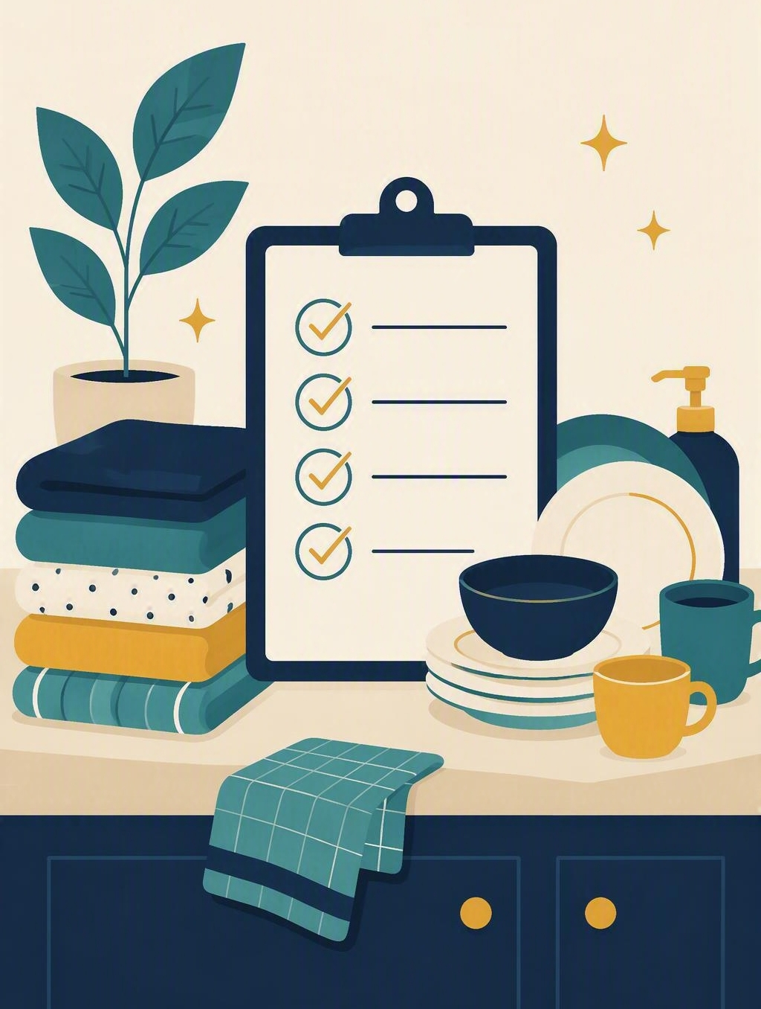
Home responsibilities
FLOURISH · CREATION
YEAR 6
Setting up one job at home with a cue, an action and a check.
#responsibility
#independence
#cuedocheck
#routines
Notes:
LEARNING INTENTION
• We are learning to set up one home responsibility using a cue, a clear action and a check.
SUCCESS CHECK
• I can write one home job for the fictional case that names a cue, a bounded action and a check, and explain why it is workable.
KEY QUESTION
• Which jobs at home only happen when somebody remembers to remind you?
NIV CONNECTION
• Colossians 3:23 – “Whatever you do, work at it with all your heart, as working for the Lord, not for human masters.” Ordinary, unseen work is worth doing well.
CHRISTIAN FORMATION
• Growing independence is part of growing up well. Working wholeheartedly means being trustworthy in small, repeated things, not being praised for them. Guard against a misreading: doing more jobs does not make anyone more loved.
• CSA alignment: Formation / Becoming; Serving / Embodying; Spirituality / Expressing.
RETRIEVAL BRIDGE
• Retrieve Week 7: a routine needs a trigger, not willpower. Retrieve Week 8: high school brings jobs nobody reminds you about.
PREPARE IN UNDER 5 MINUTES
• Write three headings: HOME NEED | CUE | CHECK. List no jobs yet; students will generate them.
SAFEGUARDING
• No forced disclosure. Students may pass, write privately or use a made-up example. Home life varies enormously and some students carry heavy caring duties – never ask who does what at home, and never compare families. Follow up any concerns privately using the school support pathway.
ACCESS / LOW-DISCLOSURE
• Read instructions aloud and display them. Allow silent pointing, writing or partner response. Provide extra processing time. Never require public role-play, prayer aloud or disclosure of personal distress.
OFFLINE FALLBACK
• Three column headings on the board plus six printed home-job cards.

Slide 2
Which jobs at home only happen when somebody remembers to remind you?
CONNECT · Jobs that need reminding
T4 · HOME RESPONSIBILITIES · WEEK 9
You can always pass, write your answer privately, or use a made-up example.
CONNECT
EXPLORE
PRACTISE
REFLECT
Notes:
FICTIONAL SCENARIO · THE MONDAY BIN
Read this aloud so students respond to the person in the story, not to their own lives. Nobody needs to share anything personal.
Nadia is in Year 6 and starts high school next year. At home the bin has to go out on Monday night, and at the moment it only happens when an adult reminds her. Nadia remembers a job easily once it is attached to something she already does, but she forgets any job that has no clear starting point.
Questions for reflection
• What is the home need here, written as an outcome rather than as a person’s name?
• Which everyday moment could work as Nadia’s cue, so the job starts without a reminder?
• What check would tell Nadia the job is actually finished, and where does the job stop?
CONNECT
• Read it aloud: “Which jobs at home only happen when somebody remembers to remind you?”
TEACHING SCRIPT
• Say: ‘Next year most of you will have jobs nobody reminds you about. Today we are setting up one home job with a cue, a clear action and a check, so it happens without a reminder.’
• Ask the opening question and give ten seconds of thinking time before any answers.
TEACHING SCRIPT
• Collect four needs and write them under HOME NEED. Examples to fish for: bins going out; lunchboxes emptied; washing moved to the line; bags packed for the next day; pets fed; dishes stacked after dinner.
• Keep families out of the list. Needs are named as general household jobs, never as who does or does not help at a student’s house.
RETRIEVAL BRIDGE
• Week 7: a routine needs a trigger, not willpower. Week 8: high school brings jobs nobody reminds you about.
FORMATIVE LOOK-FOR
• Needs are named as ordinary household jobs, not as complaints about family members.
PARTICIPATION
• Students may pass, write privately or use a made-up example. Do not ask for personal disclosure; keep the work on the fictional case.

Slide 3
Colossians 3:23
EXPLORE · Christian connection
T4 · HOME RESPONSIBILITIES · WEEK 9
“Whatever you do, work at it with all your heart, as working for the Lord, not for human masters.”
Colossians 3:23, New International Version (NIV)
CHRISTIAN CONNECTION
Ordinary home jobs are worth doing well, even when nobody is watching and nobody says thank you. Working wholeheartedly is not about being praised — it is about being trustworthy in small, repeated things.
EXPLORE
CONNECT
PRACTISE
REFLECT
Notes:
EXPLORE
• Read Colossians 3:23 aloud from the NIV, in context with verses 22–24.
TEACHING SCRIPT
• Teach the difference between a one-off favour and a responsibility. A favour happens once when someone asks. A responsibility has a clear cue, a clear action and a check: when does it start, what exactly do I do, how do I know it is done?
TEACHING SCRIPT
• Explain the check: a check is the quick way you know the job is genuinely finished – lid closed, bag packed, rack empty. Without a check, a job is only half-remembered and someone else ends up finishing it.
TEACHING SCRIPT
• Read Colossians 3:23–24. Paul is writing to people doing ordinary, unglamorous daily work. Working ‘with all your heart, as working for the Lord’ means the value of a job does not depend on who notices it.
• Land the connection on the slide: ordinary home jobs are worth doing well even when nobody is watching; wholehearted work is about being trustworthy in small, repeated things.
• Guard against a misreading: doing more jobs does not make anyone more loved, and this verse is never a reason to accept unfair or unsafe amounts of work at home.
CHECK UNDERSTANDING
• Ask: ‘What makes a job a responsibility rather than a favour?’
• Looking for: it repeats, it has a cue that starts it without a reminder, and there is a way to check it is done. Keep answers general – no personal examples needed.
PARTICIPATION
• Students may pass, write privately or use a made-up example. Do not ask for personal disclosure; keep the work on the fictional case.

Slide 4
Which of these home jobs are ready to use?
PRACTISE · Cue, do and check
T4 · HOME RESPONSIBILITIES · WEEK 9
In groups, sort the six cards into READY TO USE or NEEDS EDITING.
For any card you would edit, rewrite it so it names a cue, an action and a check.
1
Before bed on Thursday, put the washing basket by the machine and tell an adult.
2
When homework is finished, pack tomorrow’s bag and check it against the timetable.
3
After dinner on Monday, wheel the bin to the kerb and check the lid is closed.
4
Make sure nobody in the family ever runs out of clean uniform again.
5
When I put my bag down after school, rinse my lunchbox and stand it on the rack.
6
Nadia keeps the whole house tidy every single day.
Ask of every card: does it name a cue, an action and a check — and where does the job stop?
PRACTISE
CONNECT
EXPLORE
REFLECT
Notes:
PRACTISE · RUN SHEET
• Activity: sort and rewrite home-job cards using cue, do and check, working from the fictional case only.
SET UP (30 SEC)
• Groups of 3–4. Each group gets the six cards, printed or read from the screen. Say: “Four of these are ready to use. Two of them have a problem. Your job is to work out which two.”
SORT (2 MIN)
• Groups sort all six into READY TO USE / NEEDS EDITING. Circulate and listen; do not correct yet.
THE FOUR THAT WORK
• 1. “Before bed on Thursday, put the washing basket by the machine and tell an adult it is full.” Small, repeatable, and it hands the job on rather than taking over.
• 2. “When homework is finished, pack tomorrow’s bag and check it against the timetable.” The timetable is the check, so nothing depends on memory alone.
• 3. “After dinner on Monday, wheel the bin to the kerb and check the lid is closed.” Cue is a fixed weekly moment; the closed lid is the check.
• 5. “When I put my bag down after school, rinse my lunchbox and stand it on the rack.” Cue: bag down. Action: rinse. Check: it is standing on the rack.
THE TWO THAT NEED EDITING – and why
• 4. “Make sure nobody in the family ever runs out of clean uniform again.” Problem: it makes one person responsible for other people’s choices, and it cannot be checked or completed. Class rewrite might be: “On Friday after school, put my own uniform in the wash basket and tell an adult.”
• 6. “Nadia keeps the whole house tidy every single day.” Problem: there is no cue, no limit and no check – it never starts and never finishes, and it takes work that belongs to the whole household. Class rewrite might be: “After dinner, Nadia clears her own plate and wipes the table.”
• If a group defends card 4 or 6, ask: “What starts it?”, “Where does this job stop?” and “Is this person now being held responsible for someone else’s decision?”
NAME THE NEED
• Students name the home need as an outcome: ‘The bin is at the kerb before Tuesday morning,’ not ‘Nadia does more around the house.’
CHOOSE THE CUE
• Attach the job to something that already happens: after dinner on Monday. A time of day is weaker than an event that reliably occurs.
CUE–DO–CHECK
• Write it out: after dinner on Monday; wheel the bin to the kerb; check the lid is closed.
FAIRNESS TEST
• Test the job: is it useful, time-limited, age-appropriate and agreed with an adult at home? Revise it if it makes one person responsible for other people’s choices.
MODEL RESPONSE
• ‘After dinner on Monday, Nadia wheels the bin to the kerb and checks the lid is closed. Everyone still clears their own plate. An adult at home agrees the job and reviews it after two weeks.’
FORMATIVE LOOK-FOR
• Students write a home job with a genuine cue, one bounded action and a check they can actually do – not an open-ended promise.
ACCESS
• Read the cards aloud as well as displaying them. Allow silent pointing, writing, or a partner answering on a student’s behalf. Give extra processing time. No public role-play, no forced disclosure.
OFFLINE FALLBACK
• Six printed home-job cards (wording above), one set per group, plus the three board headings.
PARTICIPATION
• Students may pass, write privately or use a made-up example. Do not ask for personal disclosure; keep the work on the fictional case.

Slide 5
“When … I will … so that …”
REFLECT · My home routine
T4 · HOME RESPONSIBILITIES · WEEK 9
Write this one privately — you don’t have to share it.
TAKEAWAY
A job you can keep has a cue, one clear action and a way to check.
REFLECT
CONNECT
EXPLORE
PRACTISE
Notes:
REFLECT
• Give students the private stem: “When ___, I will ___ so that ___.” Keep it silent and private – no sharing required.
TEACHING SCRIPT
• Students privately choose one home job and one everyday moment that could act as its cue. A made-up example is completely acceptable.
TEACHING SCRIPT
• Write a one-sentence routine beginning ‘When ___, I will ___ so that ___,’ then add how they will check it is done.
• Model the size of answer you want: ‘When I hang up my bag after school, I will empty my lunchbox so that it is ready for the morning – and I will check the rack is clear.’ Small, bounded and repeatable beats impressive. Sharing is optional; students may say ‘pass’.
TEACHING SCRIPT
• Close with the takeaway on the slide, then an optional prayer: ‘God, thank you that ordinary work matters to you. Help us do the small jobs wholeheartedly, even when nobody notices. Amen.’ Never require prayer aloud; a quiet pause is an equal option.
FORMATIVE LOOK-FOR
• The routine names a cue, one bounded action and a check – not an open-ended promise to do everything.
SAFEGUARDING
• Do not read private routines aloud, and never ask students to describe or compare who does the work at home; some carry heavy caring duties. Follow up any concerns privately using the school support pathway.
PARTICIPATION
• Students may pass, write privately or use a made-up example. Do not ask for personal disclosure; keep the work on the fictional case.

