Slide 1
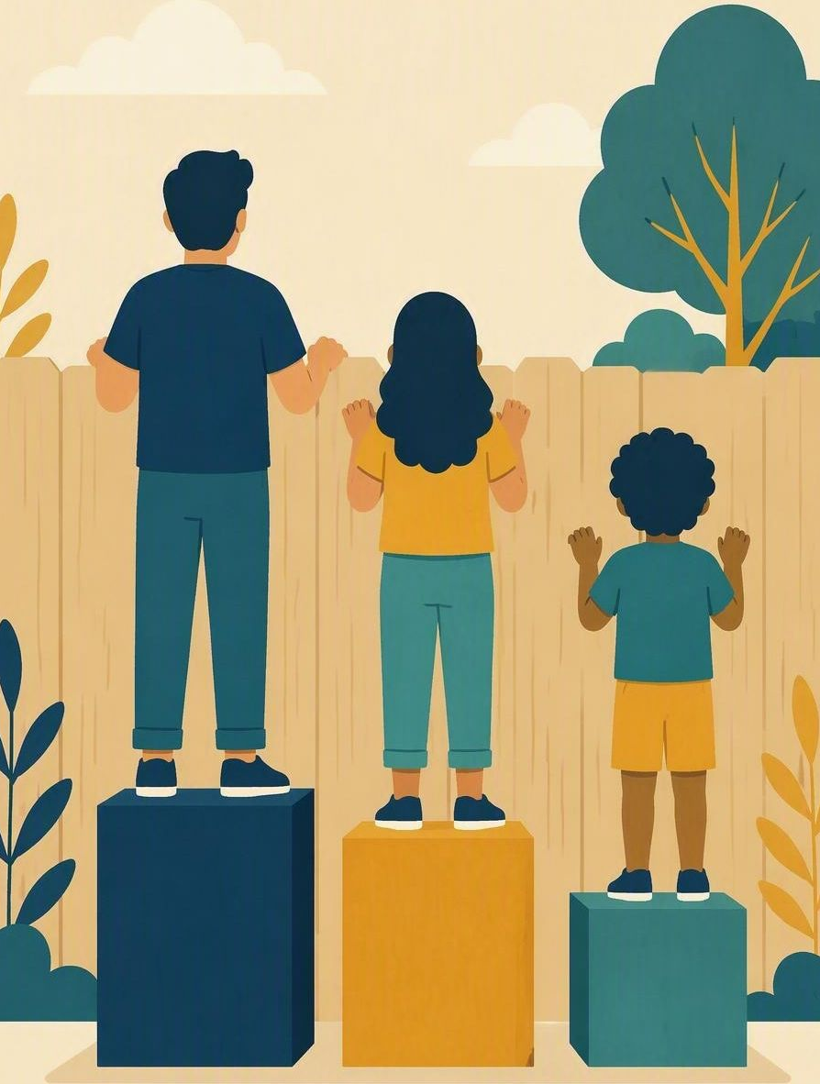
Fair is not always equal
FLOURISH · RESTORATION
YEAR 6
Three words – sameness, fairness and dignity – that help us include people well.
#fairness
#respectfulrelationships
#inclusion
#dignity
Notes:
LEARNING INTENTION
• We are learning to tell the difference between sameness and fairness, and to make changes that protect a person’s dignity.
SUCCESS CHECK
• I can explain why fair is not always equal in the fictional case, and name one change that includes Priya with dignity.
KEY QUESTION
• When does treating everyone the same stop being fair to somebody?
NIV CONNECTION
• 1 Corinthians 12:22–25; James 2:1 – greater honour where it is lacking; no favouritism.
CHRISTIAN FORMATION
• Fairness is not the same as identical treatment. God gives greater honour to the parts that lacked it, so that nobody is divided off from the body. Dignity means noticing a different need and adjusting for it quietly, without making a person a spectacle.
• CSA alignment: Relationships / Belonging; Serving / Embodying; Spirituality / Expressing. Character focus: fairness and respect.
RETRIEVAL BRIDGE
• Retrieve one class norm and one precise feeling word that could help someone notice when a person is being left out.
PREPARE IN UNDER 5 MINUTES
• Draw three labelled columns: SAME / FAIR / DIGNITY. Leave room under each heading for evidence from the case.
SAFEGUARDING
• No forced disclosure. Students may pass, write privately or use a fictional example. Follow up any concerns privately using the school support pathway.
ACCESS / LOW-DISCLOSURE
• Read instructions aloud and display them. Allow silent pointing, writing or partner response. Provide extra processing time. Never require eye contact, public role-play, prayer aloud or disclosure of personal distress.
OFFLINE FALLBACK
• Hand-drawn three-column chart on the board plus six printed action cards.

Slide 2
Everyone in a group chat gets exactly the same message, but one person cannot use it. Is that fair?
CONNECT · Same or fair?
T3 · FAIR IS NOT ALWAYS EQUAL · WEEK 5
You can always pass, write your answer privately, or use a made-up example.
CONNECT
EXPLORE
PRACTISE
REFLECT
Notes:
FICTIONAL SCENARIO · THE CLASS GAMES CHAT
Read this aloud so students respond to the person in the story, not to their own lives. Nobody needs to share anything personal.
Year 6 is planning a games afternoon in a class group chat. Priya wears a hearing aid and asks for the plan in writing as well as voice notes. Someone replies, “Everyone gets the same messages, so that is fair.” The voice notes keep coming, the chat moves on, and Priya stops asking.
Questions for reflection
• Where does treating everyone exactly the same leave Priya out?
• Which need is different here, and what would fair look like instead?
• What one change protects Priya’s dignity, and who does what next?
CONNECT
• Read it aloud: “Everyone in a group chat gets exactly the same message, but one person cannot use it. Is that fair?”
• Restate the participation options aloud: pass, write privately, or use a fictional example.
TEACHING SCRIPT
• Point to the three headings – SAME, FAIR, DIGNITY.
• Ask students to predict when identical treatment stops being fair to somebody. Thinking time first; no hands-up pressure.
TEACHING SCRIPT
• Take three or four rapid answers – ideally across all three headings.
• Say: “Fair does not mean everybody gets an identical thing; it means everybody gets what they need to take part.”
ANSWERS TO FISH FOR
• SAME – everyone gets identical voice notes. FAIR – Priya needs the plan in writing to take part at all. DIGNITY – she should not have to beg, explain herself repeatedly, or be singled out in front of the whole chat.
• If students only say “it’s the same for everyone”, ask: “Same for everyone – but who can actually use it?”
RETRIEVAL BRIDGE
• Retrieve one class norm and one precise feeling word that could help someone notice when a person is being left out.
PARTICIPATION
• Students may pass, write privately or use a fictional example. Do not ask for personal disclosure; use the fictional scenario instead.

Slide 3
1 Corinthians 12:22–25
EXPLORE · Christian connection
T3 · FAIR IS NOT ALWAYS EQUAL · WEEK 5
“Those parts of the body that seem to be weaker are indispensable … But God has put the body together, giving greater honour to the parts that lacked it, so that there should be no division in the body, but that its parts should have equal concern for each other.”
1 Corinthians 12:22–25, New International Version (NIV)
CHRISTIAN CONNECTION
Fair is not the same as identical — God gives greater honour where it is needed so that nobody is left out. Treating people with dignity means noticing different needs and adjusting, quietly and without fuss.
EXPLORE
CONNECT
PRACTISE
REFLECT
Notes:
EXPLORE
• Read 1 Corinthians 12:22–25 aloud from the screen, in context.
TEACHING SCRIPT
• Define dignity: the worth every person has because God made them – not something they earn by keeping up with everyone else.
• Say: “Fair is not always equal. Equal means the same thing for everyone; fair means everyone gets what they need in order to take part.”
TEACHING SCRIPT
• Give one worked example: glasses. Not everyone needs them, and nobody calls it cheating – the point is that everyone can read the board.
• Land the big idea: a change that meets one person’s need often makes things better for the whole group.
TEACHING SCRIPT
• Read 1 Corinthians 12:22–25 from the NIV. Paul says the body gives greater honour to the parts that seem weaker – deliberately unequal, and deliberately fair.
• James 2:1 – believers must not show favouritism. Adjusting for a need is not favouritism; it is what keeps the group whole.
• Sameness is not the same as fairness, and fairness is not the same as pity – but dignity holds all of it together properly.
CHECK UNDERSTANDING
• Ask: “Name one everyday change that is not equal but is definitely fair.”
• Looking for: a concrete change plus the need it meets – for example, captions on a video help one student and often help everyone. Keep answers general; no personal examples needed.
PARTICIPATION
• Students may pass, write privately or use a fictional example. Do not ask for personal disclosure; use the fictional scenario instead.

Slide 4
Which changes would truly protect dignity in this group?
PRACTISE · Same-or-fair card sort
T3 · FAIR IS NOT ALWAYS EQUAL · WEEK 5
Map one fact from the case beside same, fair and dignity.
Sort the six cards, then design one fair change that names who does what next.
1
Move on quickly and hope Priya asks again later
2
Say “Everyone gets the same” and leave it there
3
Post the plan as written text as well as voice notes
4
Let Priya skip the games so nobody has to wait
5
Ask Priya privately what would help her join in
6
Change the rule for everyone: plan in pairs
Test each card: is it honest? Does it include Priya? Does it protect her dignity?
PRACTISE
CONNECT
EXPLORE
REFLECT
Notes:
PRACTISE · RUN SHEET
• MAP THE CASE
• Students copy the three columns and place one fact from the case under same, fair and dignity. Some facts belong in more than one column.
• FIND THE GAP
• Circle the point where sameness stops being fair, and underline the need that is being missed.
• DESIGN THE CHANGE
• Design one change that meets the need and protects dignity. It must name who does what next.
• PARTNER TEST
• Partners test the change: Is it honest? Does it let Priya take part? Does it avoid singling her out or doing it for her?
SORTING THE SIX CARDS
• Three cards are genuinely fair; three only look fair. Do not tell students which is which. Circulate and listen; do not correct yet.
THE THREE THAT ARE FAIR
• Ask Priya privately what would help her join in – meets the real need (FAIR) and keeps her in charge of her own information (DIGNITY).
• Post the plan as written text as well as voice notes – an unequal-looking fix that quietly helps the whole chat (FAIR, DIGNITY).
• Change the rule for everyone: plan in pairs – changes the system rather than the person (FAIR), so nobody is the exception.
THE THREE THAT NEED EDITING – and why
• “Everyone gets the same” and leave it there. Problem: identical treatment is being used as an excuse; the need is real and still unmet (SAME, but not FAIR).
• Let Priya skip the games so nobody has to wait. Problem: it looks kind but removes her from the group – exclusion dressed up as consideration.
• Move on and hope Priya asks again later. Problem: it puts the whole cost on the person with the need; she has already stopped asking.
• If a group defends a weak card, ask: “Who can actually use that?” and “How would that feel if you were Priya on Monday?”
MODEL RESPONSE
• “Ask Priya privately what would help, then post every plan as text as well as voice notes, and check she has it before the chat moves on.” This meets the need without putting her on display, and it helps others too.
FORMATIVE LOOK-FOR
• Students distinguish same from fair accurately and propose a concrete change that names who does what next.
ACCESS
• Read the case and the cards aloud as well as displaying them. Allow silent pointing, writing, or a partner answering on a student’s behalf. Give extra processing time. No public role-play, no forced disclosure.
OFFLINE FALLBACK
• Board columns plus six printed action cards (wording above), one set per group.
PARTICIPATION
• Students may pass, write privately or use a fictional example. Do not ask for personal disclosure; use the fictional scenario instead.

Slide 5
“Fair is not always equal when … because dignity means …”
REFLECT · Reflection and action
T3 · FAIR IS NOT ALWAYS EQUAL · WEEK 5
Write this one privately — you don't have to share it.
TAKEAWAY
One fair change can include someone without putting them on display.
REFLECT
CONNECT
EXPLORE
PRACTISE
Notes:
REFLECT
• Give students the private stem: “Fair is not always equal when … because dignity means …” Keep it silent and private – no sharing required.
• Follow up any concerns privately using the school support pathway.
TEACHING SCRIPT
• Students finish the stem in writing. Model the size of answer you want: “Fair is not always equal when we post the plan in writing too, because dignity means everyone can join in without asking twice.” Small and doable beats impressive.
TEACHING SCRIPT
• Students draw a small star on the column – same, fair or dignity – that today’s change most clearly served. Some will star two.
TEACHING SCRIPT
• Optional class prayer: “Lord Jesus, teach us to notice what people need and to give honour where it is lacking. Amen.” Never require prayer aloud; offer a blessing or quiet pause instead if that suits the class.
• Close with the takeaway on the slide: one fair change can include someone without putting them on display.
FORMATIVE LOOK-FOR
• Students distinguish same from fair accurately and propose a concrete change. Watch for stems that name a feeling but no change, or a change with no need named.
PARTICIPATION
• Students may pass, write privately or use a fictional example. Do not ask for personal disclosure; use the fictional scenario instead.

