Slide 1
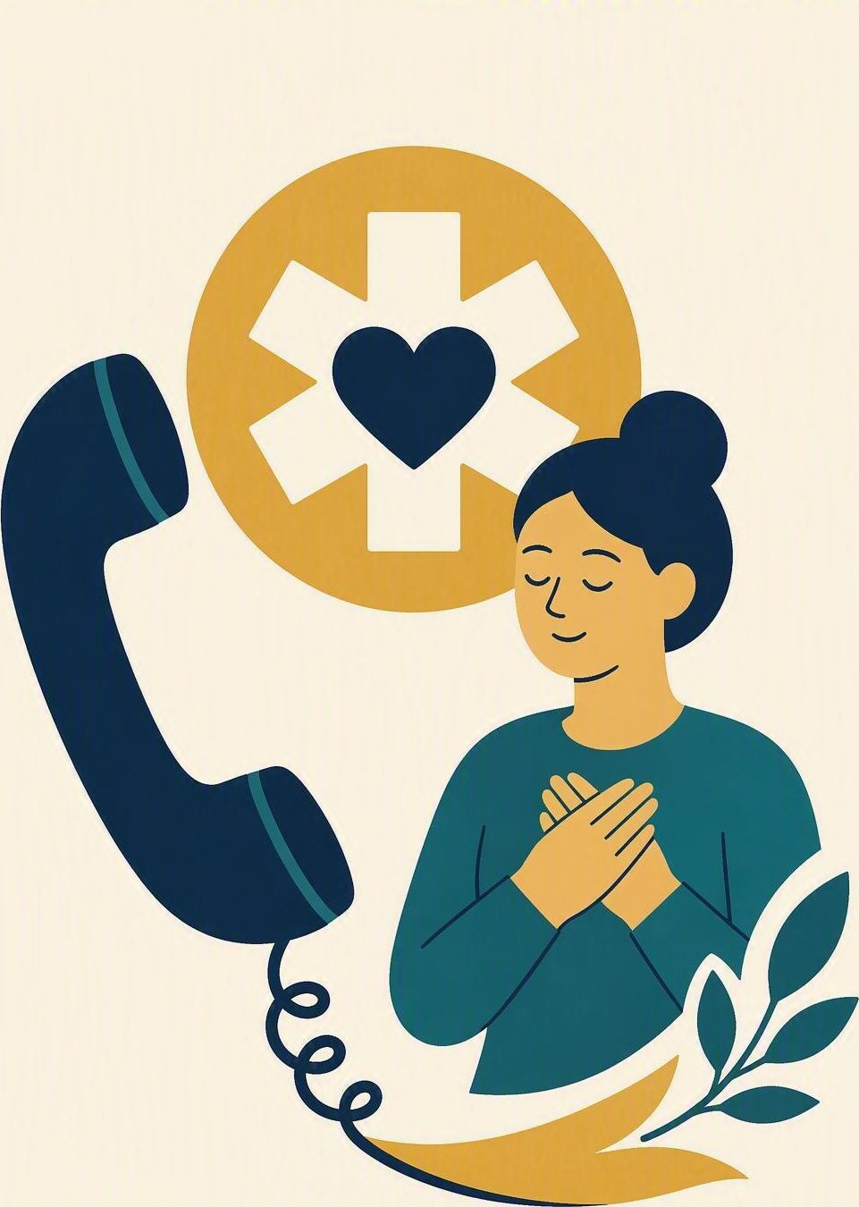
Emergency: get help
FLOURISH · REDEMPTION
YEAR 6
Recognising real danger and calling 000 clearly, calmly and early.
#safety
#lifeskills
#independence
#courage
Notes:
LEARNING INTENTION
• We are learning to recognise a real emergency and call 000 clearly and calmly.
SUCCESS CHECK
• I can decide whether the fictional situation needs 000, and say the first lines of the call.
KEY QUESTION
• How do we know it is an emergency – and what do we say when the operator answers?
NIV CONNECTION
• Psalm 46:1 – God is an ever-present help in trouble. Read Psalm 46:1–3 from the NIV in the Explore section.
CHRISTIAN FORMATION
• Christians are not asked to cope alone. God is named as refuge and present help, and part of loving a neighbour is getting them real help quickly instead of hesitating. Courage here looks like a calm phone call, not heroics.
PREPARE IN UNDER 5 MINUTES
• Write three columns on the board: DANGER SIGNS | CALL 000 | WHAT I SAY. Have the six situation cards ready.
RETRIEVAL BRIDGE
• Retrieve the Shalom compass. Ask: which direction includes protecting the safety of people around us? Expected: others – care for the people beside us.
RUN SHEET AT A GLANCE
• Connect – Explore – Practise – Reflect .
SAFEGUARDING
• No forced disclosure. Keep every example fictional. Never ask a student to describe a real accident, emergency or family crisis they have lived through; some students will have experienced serious harm or loss. Name at the start that this lesson mentions accidents and injuries, and offer a quiet exit. Watch for distress and follow up privately using the school support pathway.
ACCESS / LOW-DISCLOSURE
• Read instructions aloud and display them. Allow silent pointing, writing or partner response. Provide extra processing time and a sentence frame. Never require eye contact, public role-play, prayer aloud or disclosure of personal distress.
OFFLINE FALLBACK
• Three board columns (DANGER SIGNS | CALL 000 | WHAT I SAY) plus six printed situation cards, one set per group.
PARTICIPATION
• Students may pass, write privately or use a fictional example. Do not ask for personal disclosure; use the fictional scenario instead.

Slide 2
Someone is hurt and no adult is nearby. How do you know it is a 000 emergency — and what do you say first?
CONNECT · One clear call
T4 · EMERGENCY: GET HELP · WEEK 6
You can always pass, write your answer privately, or use a made-up example.
CONNECT
EXPLORE
PRACTISE
REFLECT
Notes:
FICTIONAL SCENARIO · JORDAN AT THE PARK
Read this aloud so students respond to the person in the story, not to their own lives. Nobody needs to share anything personal.
Jordan is walking home from the park with a younger cousin when a cyclist ahead skids on gravel, falls hard, and does not get up or answer. No adults are nearby. Jordan has a phone and can see the street name on the corner sign.
Questions for reflection
• What tells Jordan this is a real emergency and not just bad luck?
• What should Jordan say in the first ten seconds of the 000 call?
• Which details would help the ambulance arrive fastest?
CONNECT
• Read it aloud: “How do you know it is a 000 emergency – and what do you say first?”
• Restate the participation options aloud: pass, write privately, or use a fictional example.
TEACHING SCRIPT
• Write on the board: “000” and three words underneath: LOOK. CALL. TELL. Pause, then say the number aloud: triple zero.
• Say: ‘Today we are learning to spot a real emergency and get help fast – calmly, and without needing an adult to tell us to.’ Then ask the question on the slide.
TEACHING SCRIPT
• Looking for: danger signs – someone is unconscious, badly hurt, cannot breathe, is in water or in a fire, or is threatened. First words on the call: which service you need (ambulance, police or fire), then exactly where you are.
• Take two or three quick responses; no hands-up pressure. If the room is quiet, offer a starter: ‘If you rang right now, what is the very first thing the operator needs to know?’
• Land the line and write it up: ‘Calling early is never the wrong call.’ Keep it visible – the whole lesson hangs on it.
FORMATIVE LOOK-FOR
• Students name a danger sign and a first sentence for the call. If they only say ‘ring 000’, push once: ‘What are your actual first words, and how will they find you?’
ACCESS
• Display the sentence as well as saying it. Allow pointing or writing instead of speaking; give extra processing time.
PARTICIPATION
• Students may pass, write privately or use a fictional example. Do not ask for personal disclosure; use the fictional scenario instead. Keep every example about Jordan, not about anyone in the room or their family. If a student begins to describe a real emergency they lived through, thank them, move on gently, and follow up privately.

Slide 3
Psalm 46:1
EXPLORE · Christian connection
T4 · EMERGENCY: GET HELP · WEEK 6
“God is our refuge and strength, an ever-present help in trouble.”
Psalm 46:1, New International Version (NIV)
CHRISTIAN CONNECTION
God is described as help that is already there in trouble. Asking for help quickly is not weakness or panic — it is part of caring for people, and calling 000 is one real way to do it.
EXPLORE
CONNECT
PRACTISE
REFLECT
Notes:
EXPLORE
• Read Psalm 46:1–3 aloud from the NIV, in context, then leave 46:1 on the screen.
TEACHING SCRIPT
• Teach the danger signs first. Call 000 when someone is unconscious or not breathing, is bleeding badly, is in water or a fire, or when someone is in danger of being hurt. Get a trusted adult for scrapes, arguments, lost property and being late.
• Ask: ‘How would you decide, in five seconds, which of those two lists you are in?’ Looking for: is someone in danger right now, and can an adult here fix it faster than 000 can?
TEACHING SCRIPT
• The call has a shape. Say which service you need – ambulance, police or fire. Say exactly where you are: street, suburb, and a landmark. Say what happened and how many people are hurt. Then stay on the line and do what the operator says.
• Say aloud: 000 is free, works with no credit, and works from a locked phone. If you are unsure, you still ring – the operator decides, not you. You will not be in trouble for calling.
TEACHING SCRIPT
• Read Psalm 46:1–3 in context. The psalm names real trouble – shaking earth and roaring water – and still calls God a refuge who is already present. It is said to a whole community, not to one brave individual.
• Land the connection on the slide: God is help that is already there, so we do not have to freeze or pretend to be strong on our own. Asking for help fast is faithful, not weak – and looking after a neighbour is part of the job.
• Formation note for you: Trusting God is not the opposite of ringing for help; prayer and the phone call belong together. Avoid any suggestion that faith removes the need for emergency services.
• Check understanding: ‘What makes something a 000 emergency rather than a problem for a teacher?’ Looking for: someone is in danger right now and needs help faster than the adults nearby can give it. Keep answers general – no personal examples needed.
ACCESS
• Display the verse as well as reading it. Never require reading aloud or prayer aloud. Give extra processing time before questions.
PARTICIPATION
• Students may pass, write privately or use a fictional example.
• Do not ask for personal disclosure; use the fictional scenario instead.

Slide 4
Which of these needs a 000 call right now?
PRACTISE · Danger or not?
T4 · EMERGENCY: GET HELP · WEEK 6
In groups of three or four, read all six situations.
Sort them into CALL 000 NOW and TELL A TRUSTED ADULT, then plan your first sentence.
1
Your bike chain snaps and you will be late getting home.
2
A younger child is missing from the playground and cannot be found.
3
Smoke and flames are coming from a neighbour’s kitchen window.
4
Someone in the pool cannot keep their head above the water.
5
A cyclist falls, hits their head and does not wake up.
6
A friend scrapes a knee at the park and it bleeds a little.
Ask of each one: is someone in danger right now, and who can help fastest?
PRACTISE
CONNECT
EXPLORE
REFLECT
Notes:
PRACTISE - RUN SHEET
• Activity: danger-or-not sorting workshop. Keep the three board columns visible: DANGER SIGNS | CALL 000 | WHAT I SAY.
• SET UP (30 sec)
• Groups of 3-4. Each group gets the six situation cards (printed, or read from the screen). Say: “Four of these need a 000 call. Two of them do not. Your job is to work out which two.”
• SORT (2 min)
• Groups sort all six into CALL 000 NOW / TELL A TRUSTED ADULT. Circulate and listen; do not correct yet.
THE FOUR THAT NEED 000
• 2. A younger child is missing from the playground. Police. Tell the nearest adult immediately and call 000 – a missing young child is urgent, not something to wait out.
• 3. Smoke and flames at a neighbour’s kitchen window. Fire. Get well away from the building first, then call. Never go inside to check or to fetch anything.
• 4. Someone cannot keep their head above the water. Ambulance. Shout for the lifeguard and call 000. Do not jump in – reach or throw something that floats.
• 5. A cyclist falls, hits their head and does not wake up. Ambulance. Unconscious after a head injury is always 000. Do not move them; stay and answer the operator.
THE TWO THAT DO NOT - and why
• 1. A snapped bike chain and being late home. Why not: it is a problem, not an emergency – nobody is hurt or in danger. Right response: phone home or ask a known adult. Emphasise that 000 lines must stay clear for people in danger.
• 6. A scraped knee that bleeds a little. Why not: nobody is in danger and a nearby adult can help faster. Right response: find a teacher, parent or first-aid officer. If the bleeding will not stop or the injury is much worse than it looked, that becomes a 000 call.
• If a group defends card 1 or 6, ask: “Is anyone in danger right now?” and “Who can help fastest?” Never criticise a student for wanting to call – calling when unsure is safe, and the operator decides.
WORKSHOP THE SCENARIO
• Name the danger signs in Jordan’s situation: a hard fall, no response, no adult nearby. Agree as a class that this is a 000 call, not a wait-and-see.
• Build the opening line together: “Ambulance, please. I am at the corner of Ryde Street and Park Road. A cyclist fell and is not waking up.”
• Add what comes next: stay on the line, keep the younger cousin back from the road, do not move the cyclist, and wave the ambulance down when it arrives.
• Apply the three columns to one more fictional case: a stranger asleep on a footpath; a smoke alarm sounding next door; a friend stung by a bee and struggling to breathe.
MODEL RESPONSE
• “Ambulance, please. I am at the corner of Ryde Street and Park Road, near the park gate. A cyclist fell, hit his head and is not waking up. I am twelve and I will stay here on the phone.”
FORMATIVE LOOK-FOR
• Students name a danger sign, choose the right service, and give a location clearly enough for help to find them.
ACCESS
• Read the cards aloud as well as displaying them. Allow silent pointing, writing, or a partner answering on a student’s behalf. Give extra processing time. No public role-play, no forced disclosure.
OFFLINE FALLBACK
• Six printed situation cards (wording above), one set per group, plus the three board columns.
PARTICIPATION
• Students may pass, write privately or use a fictional example. Do not ask for personal disclosure; use the fictional scenario instead.

Slide 5
“If I saw an emergency, my first three steps would be …”
REFLECT · Reflection and action
T4 · EMERGENCY: GET HELP · WEEK 6
Write this one privately — you don't have to share it.
TAKEAWAY
Calling 000 early is the calm, brave choice — never the wrong one.
REFLECT
CONNECT
EXPLORE
PRACTISE
Notes:
REFLECT
• Give students the private stem: “If I saw an emergency, my first three steps would be …” Keep it silent and private – no sharing required.
TEACHING SCRIPT
• Private choice: students write three steps for a made-up emergency of their own. Say clearly: choose an imagined situation – not anything real, private or painful that has happened to you or your family.
TEACHING SCRIPT
• Each step needs a service, a place and a detail. Without a clear address or landmark, help is slower – the location is the part people forget.
• Model the size of answer you want: “Check it is safe to stay. Call 000 and ask for an ambulance. Say the street corner and stay on the line.” Small and clear beats impressive. Sharing is optional; students may say ‘pass’.
TEACHING SCRIPT
• Whisper or write the breath phrase: “God is my refuge and help; I can stay calm and get help.”
• Close with the takeaway on the slide: calling 000 early is the calm, brave choice and never the wrong one. Offer a brief prayer, blessing or quiet pause according to school practice. Never require prayer aloud.
FORMATIVE LOOK-FOR
• Students give three ordered steps that include staying safe, calling the right service, and saying where they are.
SAFEGUARDING
• Writing stays private and is not collected or read aloud. This topic can surface real accidents, loss or fear at home; watch for distress, offer a quiet exit, and follow up privately using the school support pathway. If a disclosure is made, follow mandatory reporting procedures.
ACCESS
• Display the stem as well as reading it. Drawing, a single word, or thinking in silence all count. Give extra processing time.
OFFLINE FALLBACK
• Stem and breath phrase written on the board; students use paper or a workbook page. Display the 000 steps as a reminder.
PARTICIPATION
• Students may pass, write privately or use a fictional example. Do not ask for personal disclosure; use the fictional scenario instead.

