Slide 1
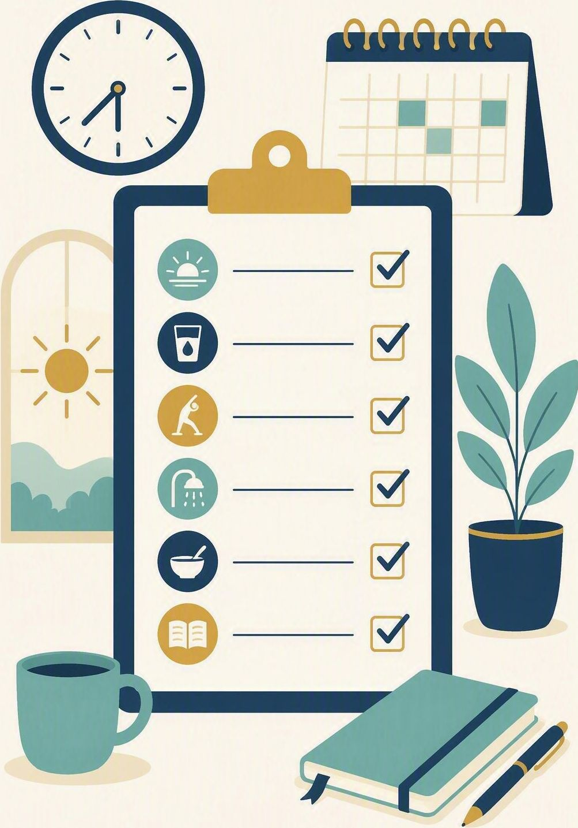
Build a workable routine
FLOURISH · CREATION
YEAR 6
Commitments and preparation steps that make the move to high school manageable.
#routine
#preparation
#independence
#responsibility
Notes:
LEARNING INTENTION
• Identify the commitments and preparation steps that make a routine workable, and commit to one.
KEY QUESTION
• What makes a routine one you actually keep, and not just one that looks good on paper?
SAFEGUARDING
• No forced disclosure. Students may pass, write privately or use a fictional example. Follow up any concerns privately using the school support pathway.
ACCESS / LOW-DISCLOSURE
• Read instructions aloud and display them. Allow silent pointing, writing or partner response. Provide extra processing time. Never require eye contact, public role-play, prayer aloud or disclosure of personal distress.
OFFLINE FALLBACK
• Printed weekly planner sheet plus the six routine cards.

Slide 2
What makes a routine one you actually keep, and not just one that looks good on paper?
CONNECT · Hook
T4 · BUILD A WORKABLE ROUTINE · WEEK 1
You can always pass, write your answer privately, or use a made-up example.
CONNECT
EXPLORE
PRACTISE
REFLECT
Notes:
FICTIONAL SCENARIO · BUILD A WORKABLE ROUTINE
Read this aloud so students respond to the person in the story, not to their own lives. Nobody needs to share anything personal.
Theo starts high school next year. On Sunday night he writes a perfect plan: up at six, homework before dinner, bag packed, phone off by nine. By Wednesday the plan has fallen apart, and this morning he missed the bus because his sports kit was still in the wash.
Questions for reflection
• Why did Theo’s plan work on Monday but fall apart by Wednesday?
• Which single preparation step would have saved his morning?
• What would make a routine Theo could keep on a busy week, not just a good week?
CONNECT · 1
• Read it aloud: "What makes a routine one you actually keep, and not just one that looks good on paper?"
• Offer a starter if the room is quiet: think of a morning that ran smoothly and a morning that did not. What was different the night before? Take two or three quick responses - no hands-up pressure.
• Restate the participation options aloud: pass, write privately, or use a fictional example.
CONNECT · TEACHING SCRIPT
• Say: 'Today we are working on the routine that gets you ready for high school - the commitments you make and the steps you take the night before. By the end you will have chosen four steps you will actually keep.'
• Read the participation line printed on the slide word for word: 'You can always pass, write your answer privately, or use a made-up example.’
• Ask: 'Name one thing that makes a morning run well, and one thing that wrecks it.' Sample answers to fish for: bag packed the night before; knowing the timetable; same wake-up time; versus late nights, lost gear, doing everything at once. Students may think, write privately or pass.
PARTICIPATION
• Students may pass, write privately or use a made-up example. Do not ask for personal disclosure; use the fictional scenario instead.

Slide 3
Proverbs 21:5
EXPLORE · Christian connection
T4 · BUILD A WORKABLE ROUTINE · WEEK 1
“The plans of the diligent lead to profit as surely as haste leads to poverty.”
Proverbs 21:5, New International Version (NIV)
CHRISTIAN CONNECTION
Steady planning is treated as wisdom, not fuss. Small preparation steps done on purpose beat last-minute rushing, and that is what a workable routine is built from.
EXPLORE
CONNECT
PRACTISE
REFLECT
Notes:
EXPLORE · 3
• Read Proverbs 21:5 aloud from the screen, in context.
• Connect diligence with the week ahead: if steady planning is called wise, what would that look like on a Tuesday night before school?
TEACHING SCRIPT
• Say: 'Today's skill: build a routine you can actually keep - the commitments and preparation steps that get you out the door ready.'
• Read the passage in context. Proverbs is wisdom writing about patterns that usually hold, not a promise that planning removes every problem.
• 'Diligent' means steady and careful rather than impressive. The contrast is with haste - doing everything at the last minute and paying for it later.
• Land the connection on the slide: small preparation steps done on purpose beat last-minute rushing.
• Make it concrete for this room: it looks like packing the bag before bed, checking tomorrow's timetable, and keeping the same wake-up time.
• Check understanding: 'If planning is wise, why do so many good plans still collapse by Wednesday?'
• Looking for: plans collapse when they are too big, too vague, or depend on a perfect week; workable steps are small, specific and repeatable. Keep answers general - no personal examples needed.
PARTICIPATION
• Students may pass, write privately or use a made-up example.
• Do not ask for personal disclosure; use the fictional scenario instead.

Slide 4
Get ready on purpose
EXPLORE · Watch together
T4 · BUILD A WORKABLE ROUTINE · WEEK 1
WATCH FOR
Preparation is a way of caring for yourself and others
Small steps repeated beat big plans done once
One commitment you could start next school morning
BibleProject · “Image of God”
bibleproject.com/explore/video/image-of-god
EXPLORE
CONNECT
PRACTISE
REFLECT

Slide 5
Which routine steps actually work?
PRACTISE · Building our routine
T4 · BUILD A WORKABLE ROUTINE · WEEK 1
In groups, sort the six cards below: WORKABLE or NEEDS EDITING.
Then agree on the four routine steps you will actually keep.
1
Get everything ready whenever I find time
2
Pack my bag the night before
3
Never be late or forget anything again
4
Check tomorrow’s timetable before bed
5
Same wake-up time every school day
6
Homework at a set time and place
Two of these drafts will not survive a busy week — rewrite them together, then keep your final four.
PRACTISE
CONNECT
EXPLORE
REFLECT
Notes:
PRACTISE - 4 - RUN SHEET
• SET UP (30 sec)
• Groups of 3-4. Each group gets the six routine cards (printed, or read from the screen). Say: "Four of these are steps you could keep on a busy week. Two of them will not survive Wednesday. Your job is to work out which two."
• SORT (2 min)
• Groups sort all six into WORKABLE / NEEDS EDITING. Circulate and listen; do not correct yet.
THE FOUR THAT WORK (answer key - teacher only)
• 2. Pack my bag the night before - specific, takes five minutes, and removes the worst part of the morning.
• 4. Check tomorrow's timetable before bed - catches sport, library books and anything unusual before it becomes a crisis.
• 5. Same wake-up time every school day - one decision made once, so the body learns the pattern.
• 6. Homework at a set time and place - a fixed slot beats willpower; the decision is already made.
THE TWO THAT NEED EDITING (teacher only) - and why
• 1. "Get everything ready whenever I find time." Problem: there is no time, no trigger and no place, so it never actually happens. Class rewrite might be: "I get everything ready straight after dinner."
• 3. "Never be late or forget anything again." Problem: it demands perfection, so one bad morning feels like failure and the whole routine gets dropped. Class rewrite might be: "If I forget something, I fix it that night and start again the next day."
• If a group defends card 1 or 3, ask: "When exactly would that happen?" and "Could you still do that on your busiest day of the week?"
• AGREE (2 min)
• Bring the class back. Land the four steps above as the class routine. Display or write them up and keep them visible for the rest of the term - refer back to them in Weeks 2-8.
ACCESS
• Read the cards aloud as well as displaying them. Allow silent pointing, writing, or a partner answering on a student's behalf. Give extra processing time. No public role-play, no forced disclosure. Be aware that home routines vary widely - never ask students to describe their own home mornings.
OFFLINE FALLBACK
• Six printed routine cards (wording above), one set per group.

Slide 6
“One step I can take this week to make my school mornings work is …”
REFLECT · Reflection and action
T4 · BUILD A WORKABLE ROUTINE · WEEK 1
Write this one privately — you don’t have to share it.
TAKEAWAY
A workable routine is small, repeatable and yours — preparation makes independence possible.
REFLECT
CONNECT
EXPLORE
PRACTISE
Notes:
REFLECT · 2
• Give students the private stem: "One step I can take this week to make my school mornings work is ..." Keep it silent and private - no sharing required.
• Close with a short prayer, blessing or silent reflection appropriate to the class. Never require prayer aloud.
• Follow up any concerns privately using the school support pathway.
REFLECT · TEACHING SCRIPT (last 2-3 minutes)
• Read the stem printed on the slide: 'One step I can take this week to make my school mornings work is ...' Students write it privately.
• Model the size of answer you want: 'I could pack my bag after dinner', or 'I could check the timetable before bed'. Small and doable beats impressive. Sharing is optional; students may say 'pass'.
• Close with the takeaway on the slide: 'A workable routine is small, repeatable and yours - preparation makes independence possible. The four steps we agreed today are ours for the whole term.' Offer a brief prayer, blessing or quiet pause according to school practice.
PARTICIPATION
• Students may pass, write privately or use a made-up example. Do not ask for personal disclosure; use the fictional scenario instead.

