Slide 1
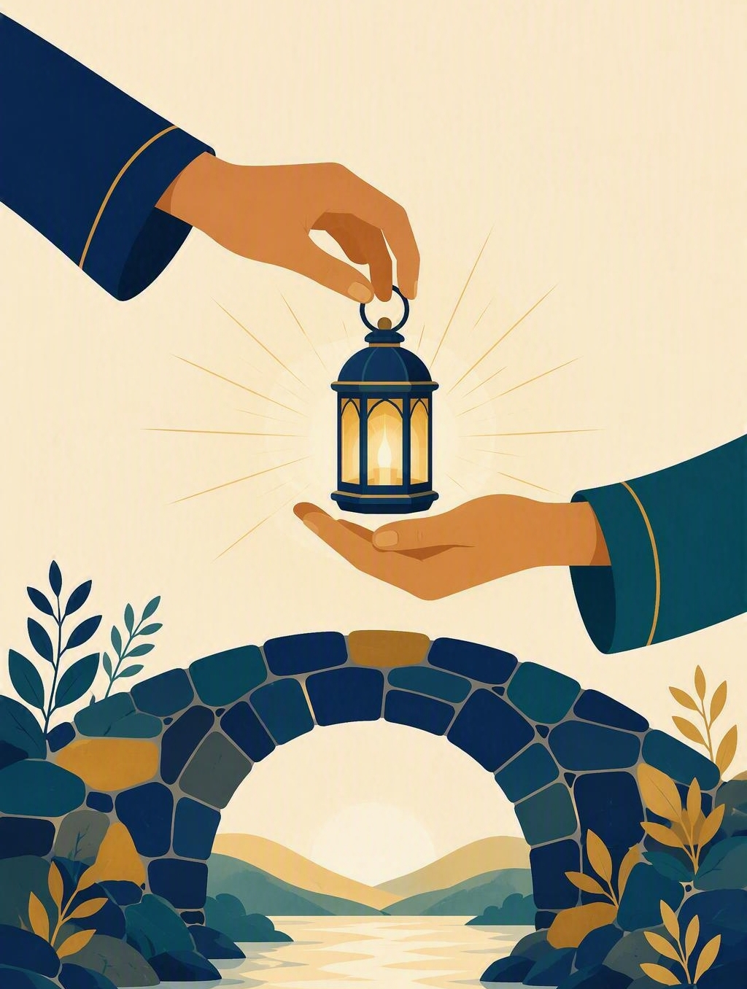
A trustworthy friend
FLOURISH · CREATION
YEAR 6
Actions that build trust over time, in person and online.
#friendship
#trust
#safety
#digitallife
Notes:
LEARNING INTENTION
• Describe actions that build trust between friends, in person and online.
KEY QUESTION
• What does someone do, again and again, that makes them a trustworthy friend?
SAFEGUARDING
• No forced disclosure. Students may pass, write privately or use a fictional example. Follow up any concerns privately using the school support pathway.
ACCESS / LOW-DISCLOSURE
• Read instructions aloud and display them. Allow silent pointing, writing or partner response. Provide extra processing time. Never require eye contact, public role-play, prayer aloud or disclosure of personal distress.
OFFLINE FALLBACK
• Printed trust-actions poster plus the six sorting cards.

Slide 2
What does someone do, again and again, that makes them a trustworthy friend?
CONNECT · Hook
T3 · A TRUSTWORTHY FRIEND · WEEK 1
You can always pass, write your answer privately, or use a made-up example.
CONNECT
EXPLORE
PRACTISE
REFLECT
Notes:
FICTIONAL SCENARIO · JONAH AND THE GROUP CHAT
Read this aloud so students respond to the person in the story, not to their own lives. Nobody needs to share anything personal.
Jonah told one friend, Ravi, that he had failed his swimming badge, and asked him to keep it quiet. Two days later a joke about it turned up in the class group chat, and Jonah could not work out who had passed it on. Ravi says he only told one other person, and that it was not a big deal.
Questions for reflection
• What has Jonah lost here, apart from a secret being repeated?
• Which small actions, repeated over weeks, would rebuild his trust in Ravi?
• What could a friend do online that would help Jonah more than saying 'just forget it'?
CONNECT · 1
• Read it aloud: "What does someone do, again and again, that makes them a trustworthy friend?"
• Offer a starter if the room is quiet: think of someone you would trust with news you did not want spread. What do they actually do? Take two or three quick responses - no hands-up pressure.
• Restate the participation options aloud: pass, write privately, or use a fictional example.
CONNECT · TEACHING SCRIPT
• Say: 'Today we are learning two things: what makes someone trustworthy, and which actions build trust over time. By the end you will have agreed the four trust actions this class will keep.'
• Read the participation line printed on the slide word for word: 'You can always pass, write your answer privately, or use a made-up example.’
• Ask: 'Name one thing a friend does that makes them easy to trust, and one thing that makes trust harder.' Sample answers to fish for: they keep their word; they do not forward your messages; they say sorry and then change. Students may think, write privately or pass.
PARTICIPATION
• Students may pass, write privately or use a made-up example. Do not ask for personal disclosure; use the fictional scenario instead.

Slide 3
Colossians 3:12–13
EXPLORE · Christian connection
T3 · A TRUSTWORTHY FRIEND · WEEK 1
“Clothe yourselves with compassion, kindness, humility, gentleness and patience. Bear with each other and forgive one another if any of you has a grievance against someone.”
Colossians 3:12–13, New International Version (NIV)
CHRISTIAN CONNECTION
Trust is built by small actions repeated over time: kindness, patience and keeping your word. That shows in how we treat friends here and in every group chat.
EXPLORE
CONNECT
PRACTISE
REFLECT
Notes:
EXPLORE · 3
• Read Colossians 3:12-13 aloud from the screen, in context.
• Connect the passage with how friends treat each other: if patience and forgiveness are what we put on, how should that show up in a friendship or a group chat?
TEACHING SCRIPT
• Say: 'Today's skill: name the actions that build trust in a friendship over time.'
• Read the passage in context. It is a letter about how a community lives together, not a rule about never being upset.
• 'Clothe yourselves' means chosen daily. Trust is built by repeated actions, not by one grand promise or one apology.
• Land the connection on the slide: kindness, patience and keeping your word are what build trust over time.
• Make it concrete for this room: it shows in what we forward, what we screenshot, and whether we keep a promise when it is inconvenient.
• Check understanding: 'If trust is built by repeated actions, what does that change about how someone rebuilds it after breaking it?'
• Looking for: one apology is not enough; it takes small, reliable actions repeated over time. Keep answers general - no personal examples needed.
PARTICIPATION
• Students may pass, write privately or use a made-up example.
• Do not ask for personal disclosure; use the fictional scenario instead.

Slide 4
Image of God
EXPLORE · Watch together
T3 · A TRUSTWORTHY FRIEND · WEEK 1
WATCH FOR
Each person is an image-bearer
Respect is owed, not earned
What that means for how we treat friends online
BibleProject · “Image of God”
bibleproject.com/explore/video/image-of-god
EXPLORE
CONNECT
PRACTISE
REFLECT

Slide 5
Which actions build trust?
PRACTISE · Actions that build trust
T3 · A TRUSTWORTHY FRIEND · WEEK 1
In groups, sort the six cards below: BUILDS TRUST or NEEDS EDITING.
Then agree on the four trust actions this class will keep.
1
You keep a confidence
2
A real friend tells you everything
3
Concerns go to a trusted adult
4
A true friend keeps every secret, always
5
You own it when you slip up
6
You keep your word
Cards 5 and 6 are the ones that need editing — rewrite them together, then keep your final four.
PRACTISE
CONNECT
EXPLORE
REFLECT
Notes:
PRACTISE - 4 - RUN SHEET
• SET UP (30 sec)
• Groups of 3-4. Each group gets the six cards (printed, or read from the screen). Say: "Four of these are ready to use. Two of them have a problem. Your job is to work out which two."
• SORT (2 min)
• Groups sort all six into BUILDS TRUST / NEEDS EDITING. Circulate and listen; do not correct yet.
THE FOUR THAT WORK
• 1. You keep a confidence - you do not forward or repeat what a friend told you privately.
• 3. Concerns go to a trusted adult - if something worries us, we tell an adult who can help.
• 5. You own it when you slip up - you say sorry plainly, and then you change what you do.
• 6. You keep your word - you do what you said you would do, even when it is inconvenient.
THE TWO THAT NEED EDITING - and why
• 2. "A real friend tells you everything." Problem: it pressures people into disclosure and ignores privacy. Class rewrite might be: "A real friend respects what you are not ready to share."
• 4. "A true friend keeps every secret, always." Problem: it sounds loyal, but it promises secrecy that cannot be kept - safety concerns must be passed on. Class rewrite might be: "A true friend keeps a confidence, unless someone is unsafe - then it goes to a trusted adult."
• If a group defends card 2 or 4, ask: "What would that rule feel like for someone having a hard week?" and "Is that a promise a friend could actually keep?"
• AGREE (2 min)
• Bring the class back. Land the four trust actions above as the class agreement. Display or write them up and keep them visible for the rest of the term - refer back to them in Weeks 2-8.
ACCESS
• Read the cards aloud as well as displaying them. Allow silent pointing, writing, or a partner answering on a student's behalf. Give extra processing time. No public role-play, no forced disclosure.
OFFLINE FALLBACK
• Six printed trust cards (wording above), one set per group.

Slide 6
“One action I can take this week to be a more trustworthy friend is …”
REFLECT · Reflection and action
T3 · A TRUSTWORTHY FRIEND · WEEK 1
Write this one privately — you don't have to share it.
TAKEAWAY
Trust is not declared, it is built by small actions repeated over time.
REFLECT
CONNECT
EXPLORE
PRACTISE
Notes:
REFLECT · 2
• Give students the private stem: "One action I can take this week to be a more trustworthy friend is ..." Keep it silent and private - no sharing required.
• Close with a short prayer, blessing or silent reflection appropriate to the class. Never require prayer aloud.
• Follow up any concerns privately using the school support pathway.
REFLECT · TEACHING SCRIPT (last 2-3 minutes)
• Read the stem printed on the slide: 'One action I can take this week to be a more trustworthy friend is ...' Students write it privately.
• Model the size of answer you want: 'I could stop forwarding messages about other people', or 'I could do what I said I would do'. Small and doable beats impressive. Sharing is optional; students may say 'pass'.
• Close with the takeaway on the slide: 'Trust is not declared, it is built by small actions repeated over time. The four trust actions we agreed today are ours for the whole term.' Offer a brief prayer, blessing or quiet pause according to school practice.
PARTICIPATION
• Students may pass, write privately or use a made-up example. Do not ask for personal disclosure; use the fictional scenario instead.

